Slide 1
State Government

Slide 2
Bellringer 4/10
What do you know about North Carolina’s government?

Slide 3
Federal System
Constitution established a federal system
Some powers belong just to the federal government, some to the state, and some are shared.

Slide 4
State Government
State (1): a political unit that has authority to govern itself
State can establish rules for the health, safety and welfare of their citizens.
Reserved powers: powers held solely by the states
The 10th Amendment is the Constitutional basis for reserved powers.

Slide 5
Local Government
The Constitution says nothing about counties, cities, towns, boroughs, or any other small unit of government.
The states decide what kinds of smaller governments to create and what powers those local governments will have.
States rely on local government to deliver certain kinds of services to people.

Slide 6
Federal and State
The Federal government may like to pass a nationwide law, but because of the state/federal power split, it can’t.
It can influence states to change their own laws and implement programs through funding.
Grants-in-aid (2): federal funds given to state and local government for a specific purpose
Block grants (3): funds given by federal government for a broadly defined purpose.

Slide 7
State constitutions
In 1777 the Continental Congress asked all 13 states to set up their own governments by creating a state constitution.

Slide 8
NC Constitution
Purpose of NC Constitution is
to protect the rights of the individual
to provide a framework of government
The NC Constitution is modeled after the US Constitution and based on the same principles.
“Please let Friday come soon”

Slide 9
North Carolina Constitution
Why is the NC Constitution overlooked?
What can state constitutions guarantee?
What is being eroded in the US?
Do you agree with Kickler’s point of view?
https://www.youtube.com/watch?v=-erl3SPJZKo

Slide 10
NC Constitution
North Carolina has written 3 constitutions. Like most state constitutions, the North Carolina Constitution is modeled after the US Constitution. However, like most other state constitutions it is longer in length. The principles of the NC Constitution include popular sovereignty, limited government, separation of powers, and checks and balances.

Slide 11
NC Constitution
The NC Declaration of Rights is similar to the US Constitution Bill of Rights. Changes to the Constitution are called amendments. They may be introduced by a convention of people or legislative initiative . The citizens may vote to accept or reject an amendment or law by a referendum. Unlike the US Constitution where amendments are placed at the end of the document, amendments to the NC Constitution are incorporated or included throughout the document.
Declaration of Rights (4): Formal declaration outlining the specific rights of citizens; akin to the Bill of Rights

Slide 12
Amending the NC Constitution
There are two methods of amending the NC Constitution.
Convention of the people
Legislative initiative
Both methods require a referendum
A referendum (5): referring measures proposed or passed by a legislative body to the people to approve or reject
The people have the final say

Slide 13
State Separation of Powers
Legislative: General assembly
Senate: 50; term is 2 years
House of Representatives: 120; term is 2 years
Executive: Governor/Lieutenant Governor
Term: 4 years
Veto power in 1996
Judicial: General Courts
Appellate Division, Superior Division, District Division

Slide 14
Local Separation of Powers
Two levels of local government are counties and municipalities.
County:
Legislative: County Commissioners
Executive: Sheriff
Judicial: Clerk of Court, Register of deeds
Municipality:
Legislative: City Council or Aldermen
Executive: Mayor elected and manager hired
Judicial: Small claims court
State laws are statutes and local laws are ordinances

Slide 15
Bellringer 4/11
Describe how one of the principles of the Constitution is reflected in state government.

Slide 16
Separation of Powers
North Carolina state government is divided into 3 branches.
Legislative
Creates laws
Executive
Enforces laws
Judicial
Interprets laws

Slide 17
North Carolina Legislature
General Assembly (6): North Carolina’s legislature
The General Assembly is bicameral and has a House of Representatives and a Senate.
Length of session varies
2016: short session
2017: long session

Slide 18
NC Legislature
Senators: 50
Leaders:
Lieutenant Governor = President of the Senate
The Senate also elects a President Pro Tempore
Serve 2 year terms
Qualifications:
25 years of age
Qualified voter of the State
Resided in the State as a citizen for two years
Reside district one year before his election.

Slide 19
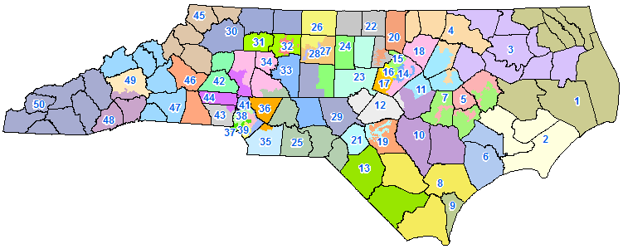

Slide 20
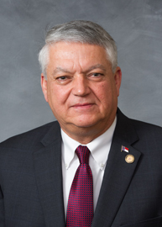
Senate District 2
Norman Sanderson
Represents Carteret, Craven, and Pamlico counties.

Slide 21
NC Legislature
House Representatives: 120
Leaders: elects a Speaker of the House
2 year term
Qualifications:
Every NC voter who is at least 21 years of age is eligible to run for office
Reside in the district for one year before election

Slide 22
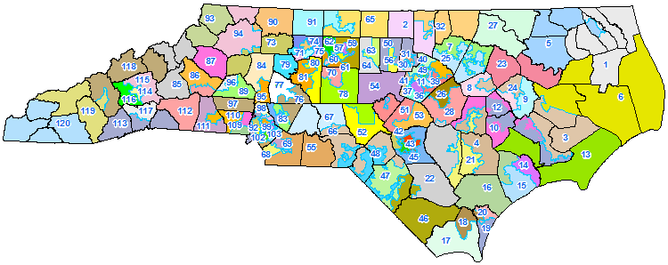

Slide 23
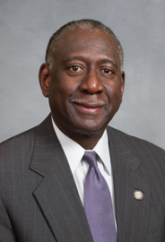
District 12
George Graham
District includes parts of Lenoir, Craven, and Greene counties.

Slide 24
District 10
John Bell
District includes parts of the Craven, Greene, Lenoir, and Wayne counties.

Slide 25
District 3
Michael Speciale
District includes parts of Craven, Pamlico, and Beaufort counties.

Slide 26
Passing State Laws
State pass laws governing all areas within their responsibility.
State statutes apply to the entire state of NC.

Slide 27
Passing State Laws - NC
Final stop for the bill is the governor.
Governor may veto a bill
Governor’s veto may be overridden by 3/5 vote
If not vetoed by the governor within the time limit it will become law.
10 days if in session
30 days if adjourned
Many states allow the governor to veto only one part, or item, of an appropriation bill.
A line item veto.
NC does NOT have line item veto

Slide 28
NC Constitution
http://www.ncleg.net/Legislation/constitution/ncconstitution.html

Slide 29
Executive Branch: Governor
Executive shares power with the legislative and judicial branch.
Article III outlines the role of the governor.
Governor (7): chief executive of the state
New governor every 4 years.
Qualifications
At least 30 years of age
Citizen of Us for at least 5 years
Resident of NC for at least two years before election
No more than 2 consecutive terms
Oath of office given by any justice of NC Supreme Court
Governor always prepares a state budget
Powers:
Clemency: give reprieves and pardons
Appointment: appoint positions
Veto: not approve legislation

Slide 30
Executive Branch: Lieutenant Governor
NC elects a Lieutenant Governor every 4 years
The Lieutenant Governor may become governor
Lieutenant Governor serves as president of the Senate but does not vote unless there is a tie

Slide 31
NC Executive Branch
Article III allows the election of 8 others
Included within the executive branch is the Council of State.
The Council of State (8) is a group of popularly elected executive offices.

Slide 32
Executive Branch: Council of State
Council of State
Secretary of State: elections, archives, corporations
State Auditor: reviews other state departments
State Treasurer: money
Superintendent of Public Instruction: public school system
Attorney General: provides legal advice to state and local government, conducts investigations and prosecutions
Commissioner of Agriculture: safety of agricultural products
Commissioner of Labor: worker safety and employment
Commissioner of Insurance: regulate insurance company
Members of the Council of State are elected for 4 year terms

Slide 33
NC Executive Branch
The governor also has a cabinet consisting of the heads of various state departments.
Cabinet (9): group of unelected heads of executive departments that are appointed by the governor of approved by Senate.
Cabinet includes:
Secretary of Administration
Secretary of Cultural Resources
Sectary of Health and Human Services
Secretary of Public Safety
Secretary of Commerce
Secretary of Transportation
Secretary of Environment and Natural Resources
Secretary of Revenue

Slide 34
Powers and Duties of Governor
Budget
Prepares and recommends a budget to the General Assembly
Execution of the Laws
The Governor shall take care that the laws be faithfully executed.
Assists in lawmaking process; received veto power in 1996
Commander in Chief
The Governor is Commander in Chief of the military forces of the State except when called into the service of the US
Clemency
May grant reprieves, commutations, and pardons
Appointments and administrative reorganization
Makes appointments with advice and consent of majority of Senate

Slide 35
Courts: Judges
Article IV outlines the General Courts of Justice
Appellate division
Superior Court Division
District Court Division
Shares power with executive and legislative
Appellate division: Supreme Court and Court of Appeals
Supreme Court is highest with a Chief Justice and 6 associate justices
District court judges elect for 4 years; all others for 8 years
To be a judge you must be authorized to practice law in NC

Slide 36
NC Court
District Court
Civil; criminal; juvenile; magistrate
Bench trial
Judges serve four year terms
Superior Court: Court of general jurisdiction; where jury trials and felonies cases are heard
Judges serve eight year terms
North Carolina Court of Appeals
Three judge panel
Judges serve eight year terms
North Carolina Supreme Court
Chief Justice and six associate justices
Judges serve eight year terms

Slide 37
State Agencies and Officials
Department of Transportation
Providing safe and efficient transportation system
Register of Deeds
Custodian for land transactions documents and other legal documents
Clerk of Court
Custodian of court records but also oversees probate of wills and other special proceedings
Highway patrol
Primary mission is to reduce collisions and make the highways of North Carolina as safe as possible
State Bureau of Investigations
Assist local law enforcement with criminal investigations

Slide 38
NC History
Eugenics is the study of hereditary improvement of the human race by controlled selective breeding.
About 7600 people were sterilized under the eugenics program from 1929-1976.
Advocates wanted a way to cleanse society of mentally handicapped and mentally ill.
They used sterilization to cure social ills by preventing those considered “unfit” from having children

Slide 39
NC History
North Carolina eugenics program was the third largest in the nation.
Sterilization was overseen by the Eugenics Commission, a panel of five people.
Appointed by governor
The Eugenics Commission was formally abolished by the legislature in 1977.

Slide 40
“Lifting the Curtin on a Shameful Era”
Think about…
What surprised you as you read?
What did you agree with? What did you disagree with?
We will examine a 1976 NC Supreme Court case involving sterilization.

Slide 41
In re Moore
The NCSC held that the State could constitutionally sterilize Moore.
The court held that Moore’s constitutional right to reproduce was outweighed by the State’s interest in sterilizing Moore to protect the welfare of his unborn children, society, and himself.

Slide 42
NC History
In 2003 North Carolina officially repealed its sterilization law.
The General Assembly determined that victims should receive treatment for the mental and physical ills left by their sterilization.
In 2013 a 10,000,000 fund was established to pay victims of sterilization.

