Slide 1
Local Government

Slide 2
Bellringer 4/12
How is separation of powers represented at the state level?

Slide 3
Local Authority
All state constitutions lay out rules for establishing local governments.
“The General Assembly shall provide for the organization and government and the fixing of boundaries of counties, cities and towns, and other governmental subdivisions, and, except as otherwise prohibited by this Constitution, may give such powers and duties to counties, cities and towns, and other governmental subdivisions as it may deem advisable”
Local governments get their charter from the state
Charter (10): A basic plan of government granted by state legislatures to local governments
Two main types of local government in NC:
Municipality and Counties

Slide 4
Types of Local Governments
Counties: largest subdivision of a state.
NC has 100 counties
Municipalities (11): Unit of government that is incorporated by the state and has a large degree of self-governance
City
Metropolitan area
Town
Borough
Village

Slide 5
Functions of Local Governments
Education
Transportation
Social Services
Sewage & Sanitation
Zoning (land use)
Police & Fire
Recreation
Elections

Slide 8
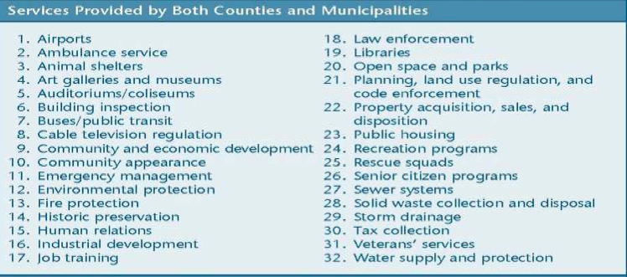

Slide 9
County SOP
Legislative:
Board of Commissioners
Craven County has 7 commissioners
Ordinances(12): regulations that govern a community
Adopt a budget
Meeting
Executive:
Sheriff
Judicial:
Register of Deeds: keeper of public records
Clerk of Court: keeper of court records
County conducts its business in the county seat.
All are elected

Slide 10
Municipalities
Municipalities (cities, towns, and villages) are incorporated within counties

Slide 11
Municipalities
Voters in each municipality elect their own governing board,
Called a council, board of aldermen, or board of commissioners.
City of New Bern has a Board of Aldermen
They make all official decisions for the city
Advisory boards often offer recommendations in areas

Slide 12
Municipalities
Most cities elect a mayor but they may not have much power.
Weak mayor
Mayor serves a ceremonial role
City manager, hired by council, carries out policies
Strong mayor
Mayor serves as chief executive
Municipalities in NC use the weak mayor-council-manager plan.

Slide 13
Municipalities
Legislative: Councils
Make ordinances
Approve personnel & budget
Levy taxes
Mayors: Ceremonial Executive
Make appointments to Advisory Boards
Ceremonial Functions
Managers: Chief Executive
Make budget
Carry out ordinances
Oversee non-elected personnel; hire non-elected department heads

Slide 14
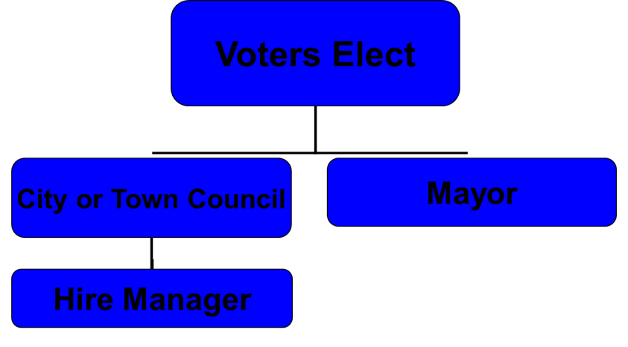

Slide 15
Local Government
Local government considered most democratic because town meetings are held for the public to voice their concerns.
Some small towns have decisions made at town meetings.
Some local government allow initiatives
Initiatives (13): citizens are able to start new legislation

Slide 16
State Controversies
Annexation: City expands by incorporating outlying areas
Pro: utility and police/fire services
Con: higher taxes
Balanced budget: NC Constitution says government spending must equal revenue
Pro: no debt
Con: difficult to do; raise taxes or spend less

Slide 17
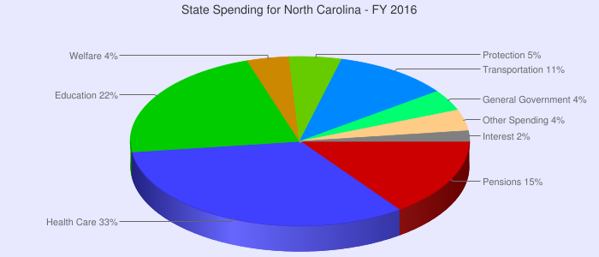

Slide 18
Controversies
State lottery: Education lottery raises money for education
Pro: raise money without new taxes
Con: Gambling is immoral, disadvantages poorer citizens, education getting less money
Lottery
Charter Schools: Public schools for specific needs (behaviorally challenged or exceptional students)
Pro: Alternative to public education; meets special needs
Con: Public taxes for small population; take away diversity from public schools

Slide 19
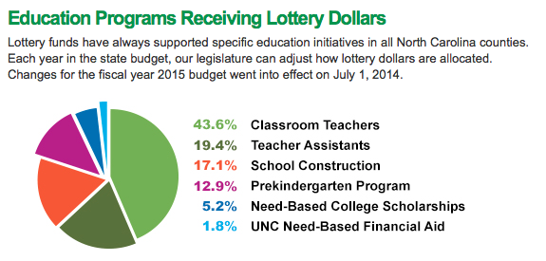
State Controversies

Slide 20
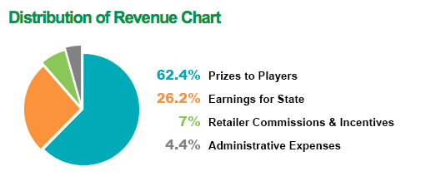
State Controversies

Slide 21
State Controversies
School bussing: Ensure diversity in schools by bussing students from different neighborhoods
Pro: prevents de facto segregation
Con: Inconvenience; makes race an issue
Redistricting: done every 10 years with new census by state legislature to reapportion
Pro: make sure districts are even in population
Con: gerrymandering

Slide 22
Reflections
Answer the following questions
1. Review the local government jobs you have now learned about. Choose three jobs that you think are most important and explain why.
2. Which local government employee or department provides a service that impacts you the most? Explain.
3. Which of the jobs would be the most difficult to perform and why?
4. Of all the jobs in local government, which would you most like to perform and why?

