Slide 1
Equal Justice Under Law

Slide 2
Bellringer 3/30
What are some different types of laws?

Slide 3
A Nation of Laws
Rule of law: Law should govern a nation and not arbitrary decisions of government officials
Laws are created and enforced to ensure domestic tranquility.
Public policy is frequently created through laws.

Slide 4
Where do our laws come from?
Constitution
Supreme law of the land
Statutes
Statutes (1): a law enacted by a legislature; federal and state law
Regulations
Rules created by an agency
Precedent
Precedent (2): A court decision that is cited as an example or analogy to resolve similar questions of law in later cases

Slide 5
18 U.S.C. § 594

Slide 6
18 U.S.C. § 1111

Slide 7
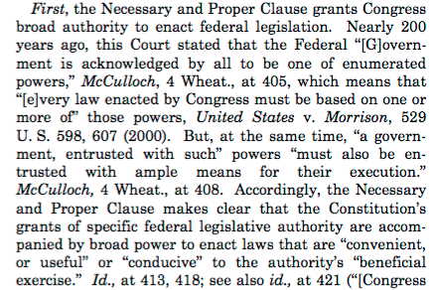
US v. Comstock

Slide 9
Types of Law
Criminal
Civil
Public
International

Slide 10
Types of Laws
Criminal Law (3)
Ensures people’s rights to remain free from bodily harm or unlawful injury to their property are protected
Mala in se/ Mala prohibitum
Civil Law (4)
The body of laws regulating ordinary private matters and disputes between individuals
Refers to disputes between parties

Slide 11
Types of Laws
Public laws:
Constitutional law ensures that people’s individual rights are protected
civil rights and civil liberties
Administrative law (5): the body of law that regulates the operation and procedures of government agencies
International laws
Consist of treaties, customs, and agreements among nations.

Slide 12
Equality
“All men are created equal…”
Fourteenth Amendment provides the legal basis for our evolving ideas of equality and fairness.
14th Amendment (6): Amendment that was ratified in 1868 that defined national citizenship and forbade states from restricting the rights of citizens or persons

Slide 13
14th Amendment
Section 1. All persons born or naturalized in the United States and subject to the jurisdiction thereof, are citizens of the United States and of the State wherein they reside. No State shall make or enforce any law which shall abridge the privileges or immunities of citizens of the United States; nor shall any State deprive any person of life, liberty, or property, without due process of law; nor deny to any person within its jurisdiction the equal protection of the laws.

Slide 14
Equal Protection
Does the Fourteenth Amendment require that everyone be treated identically?
If "equal" is not the same as "identical," what is it exactly?

Slide 15
Equal Protection
EPC is not intended to provide equality among individuals or classes but only "equal application" of the laws.
By denying states the ability to discriminate, the EPC is crucial to civil rights.
Challenges occur when a state grants a particular class of individuals the right to engage in an activity yet denies other individuals the same right.

Slide 16
Equal Protection
Before deciding whether a law that treats different classes of people differently violates the equal protection clause, a court must determine which constitutional test to apply:
Strict Scrutiny: Is the law narrowly tailored to be the least restrictive means of accomplishing a "compelling" government interest?
Intermediate scrutiny: Is the law substantially related to an "important" government interest?
Rational basis: Is the law reasonably related to a "legitimate" government interest?

Slide 17
14th Amendment Situations
1. After analyzing statistics on driving under the influence of alcohol and accident rates for drivers from ages 18-21, a state allows females to drink alcohol at 18 but makes males wait until 21.
2. The National Honor Society at a public high school tells unmarried teenager girl that she was not selected because she is pregnant.
3. A state university has more sports programs for males than they do females.
4. A state law requires that 20% of the contracts to build highways be awarded to minority-owned firms since that reflects the demographics of the state population.

Slide 18
14th Amendment Situations
5. A wealthy suburban community spends twice per student to education their children than does a poor one.
6. A state’s ethic intimidation law provides special punishment for hate crimes that are based on gender, race, ethnic origin, and disability. No protection is provided because of sexual orientation.
7. State troopers are required to retire at age 50.
8. A public school creates separate classes for girls and boys because they believe that the girls will do better in science and math of boys are not present.

Slide 19
Writing Prompt
Although the law says that groups of people can not be treated differently based on their race, gender, or ethnicity. There is one big exception.
Affirmative Action
Do you think that affirmative action is constitutional according to the 14th amendment?

Slide 20
Bellringer 3/31
What are the four types of laws?

Slide 21
Jurisdiction
Federal
State
Crime that is a violation of federal law
Cases involving interstate commerce or interstate criminal activity
Civil cases based on federal law
Controversy arising out of the Constitution
All bankruptcy, patent, and copyright cases
Crime that is a violation of state law
Controversy arising out of state constitution
A case where the state is a party
Most real estate, personal injury, and contract cases
All family, divorce, custody, inheritance and probate cases

Slide 22
Federal Courts: District Courts
Only district courts have trials.
Jury acts as the fact finder
Exercise original jurisdiction.

Slide 23
Federal Courts: Court of Appeals
Hear cases from federal district court.
Appellate jurisdiction
Case through oral argument and filed briefs.
A three judge panel will issue a written opinion.
Decision is precedent for the circuit.

Slide 24
Federal Courts: Supreme Court
Has original and appellate jurisdiction.
Gets to decide what cases it will hear
Writ of certiorari
Need 4 justices to agree to grant cert
Attorneys present cases through oral argument and briefs.
Interest groups and other may submit amicus curiae
Need 5 justices to make a decision

Slide 25
Supreme Court Cases
The Supreme Court may issue different opinions
The Court may
Reverse (7): undo the decision of a lower court
Remand (8): send a case back down to a lower court
Affirm (9): to declare a judgment, decree, or order valid and to concur in its correctness
Decisions of the Supreme Court are binding on ALL jurisdictions and can not be appealed

Slide 26
Types of Law
Criminal
Civil

Slide 27
Types of Law
Criminal
Civil
Violation of a criminal law
Prosecution
Burden of proof on prosecution
Beyond a reasonable doubt
Guilty/not guilty
Jail, probation, fine, house arrest
Ex:
Kidnapping
Murder
Robbery
Settling a personal dispute
Plaintiff
Burden of proof typically on plaintiff
By a preponderance of the evidence
Liable/not liable
Monetary damages or compliance
Ex:
Personal injury
Negligence
Divorce

Slide 28
Civil Process

Slide 29
Civil Proceedings
Civil suits are actions people take out against others for non-criminal activity.
Plaintiff (10) is the party that brings the lawsuit against another person.
The defendant is the party being sued
Civil proceedings cover a range of issues but many are torts.
Tort (11): civil wrongs recognized by law as grounds for a lawsuit
Coffee
Outcome sought is usually money or a desired action

Slide 30
Step 1: Complaint
The plaintiff will file the complaint
Cause of action
Lists redress sought by court
The plaintiff must serve the defendant
Issue a summons - an official order to appear before court
Puts defendant on notice there is a lawsuit against them

Slide 31
Step 2: Answer
The defendant will reply with an answer
Address allegations made
Must list counterclaims and affirmative defenses

Slide 32
Step 3: Discovery
Discovery is the pre-trial phase in a lawsuit where a party can obtain evidence from the opposing party.

Slide 33
Step 4: Trial
Plaintiff must prove by a preponderance of the evidence the defendant is liable.
If liable, judgment will be entered against the defendant
Sometimes a settlement is reached prior to trial through attorneys or through a third party
Mediation – decision not binding
Arbitration – decision binding

Slide 34
Appeal
If there is believed to be an error in the lower court’s decision, a person can appeal.

Slide 35
Bellringer 4/3
What do think of when you think about criminal law?

Slide 36
Criminal Justice System
The criminal justice system has three main components
Policing
Courts
Corrections
All three work together under the rule of law and with the purpose of maintaining the rule of law.

Slide 37
Crime in the United States
A crime (12) any act that breaks the law for which there is a punishment.
A criminal is the person who commits any type of crime.
Serious crimes are felonies
Less serious crimes are misdemeanors
Crimes can be categorized other ways as:
Crimes against persons
Crimes against property
Victimless crimes
White collar crimes
Organized crimes

Slide 38
Policing
Each level of government has different government officials
Federal
Department of Justice
FBI
DEA
ATF
Homeland security
State
Department of Justice
NC State Bureau of Investigations
NC Highway Patrol
Local
Sheriff
City Police

Slide 39
Arrest
Police may arrest a person with probable cause or with an arrest warrant.
Probable cause (13) is the standard by which an officer has the grounds to obtain a warrant or make an arrest.

Slide 40
Charges filed
The prosecutor will decide what charges to pursue.
Prosecutor (14):The government attorney charging and trying the case against a person accused of a crime
A person may only be tried for a felony only upon indictment issued by a grand jury.
An indictment (15): is a formal charge or accusation of a serious crime
Grand jury (16): A group of people that operate in closed proceedings to determine if there is enough evidence to charge that person with the crime

Slide 41
Courts: First Appearance
At the first appearance
Inquire about intent to hire an attorney
Defendant will enter a plea
Guilty – sentencing begins
Not guilty – set trial date
Determine whether to set bail
The amount of bail is determined by the judge based on your flight risk and danger to the community.
Set any conditions for release
Set date for future proceedings

Slide 42
Courts: Trial
Prior to trial a plea agreement can be reached and settle the case without a trial.
Parties reach a mutually satisfactory resolution
A trial is an adversarial procedure.
Each side presents its case as persuasively as possible and an independent fact finder, decides in favor of one side or the other.
Prosecutor v. defendant
Defendant(17): The party being sued or accused of some action in a court of law

Slide 43
Courts: Trial
Prosecution will present their case at trial though witness testimony and physical evidence.
Subpoena (18): An order from a court requiring testimony of witness or production of evidence under penalty for failure
The prosecution has the burden of proving the elements of the crime beyond a reasonable doubt.
Defense does NOT have to present any evidence
Juries must reach a unanimous decision

Slide 44
Courts: Appeal
In a criminal case, the defendant may appeal a guilty verdict, but the government may not appeal if a defendant is found not guilty.
Either side in a criminal case may appeal with respect to the sentence that is imposed after a guilty verdict.

Slide 45
Corrections
The punishment for lawbreakers is handled by the corrections system.
Corrections can vary and range from probation to the death penalty.
Which amendment provides restrictions on punishment?
4 main purposes
Retribution: administer punishment
Incapacitation: protect community
Deterrence: discourage from doing again
Rehabilitation: change behavior

Slide 47
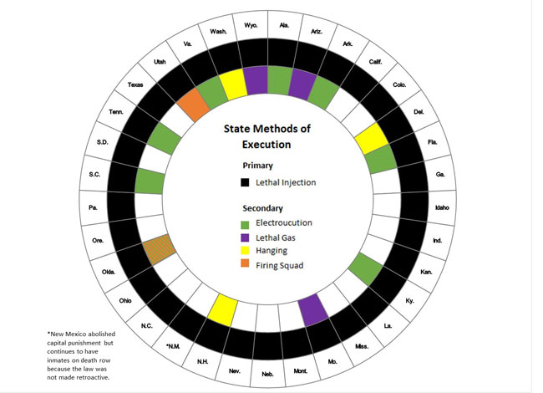

Slide 48
Rights of the Accused – 4th Amendment
4th Amendment requires police have a search warrant to search a person’s home
Search warrant must state what looking for and where looking

Slide 49
Legal or Illegal Search
If police are outside a house, and they can smell burning marijuana and hear the sounds of evidence being destroyed, are they allowed to enter without a warrant?
The police, without a warrant, find incriminating evidence after searching trash bags that have been placed on the curb for garbage collection.
A student is declared to be a delinquent after school officials, based on allegations she was smoking in the restroom, search her possessions and discover drug paraphernalia.

Slide 50
Legal or Illegal Search
After she violates her school’s cell phone policy, a student’s confiscated cell phone is searched by school officials for evidence of illegal activity.
A potential candidate for state office is requires to take a drug test before his name is added to the ballot.
A student trying out for a spot on high school sports team is required to take a drug test before he can join.
In order to collect evidence, the police place a wiretap in a public phone booth frequently used by an individual who is suspected of illegal gambling.

Slide 51
Mapp v. Ohio (1961)
Police were searching for a bombing subject in Ms. Mapp’s home. Upon her refusal to allow the police to search her home, the police presented her with a a fake warrant. The police found obscene materials and Ms. Mapp was charged.
Evidence obtained in violation of the 4th amendment may not be used in state law criminal prosecutions.
Mapp v. Ohio Extended exclusionary rule to state courts; fruit of the poisonous tree.

Slide 52
Rights of the Accused – 5th Amendment
Requires an indictment by a grand jury for felonies
Right against self-incrimination
Miranda Rights
Due process of the law
Guarantee that all legal proceedings will be fair
The right to be tried only once
Double Jeopardy(19): second prosecution for the same offense after acquittal or conviction or multiple punishments for same offense

Slide 53
Rights of the Accused: 6th Amendment
Right to a speedy and public trial
Right to assistance of counsel
Right to confront witnesses against you
Right to a jury trial
Gideon

Slide 54
Basic Courtroom Steps
Opening Statement: explain what their evidence will be and what they will try to prove.
Case-in-chief: witness are called to testify and other physical evidence is introduced.
Plaintiff/prosecutor presents full case first and each witness is cross-examined by the defense
Defendant then presents case and witnesses are cross-examined by plaintiff/prosecutor
Perjury (20): the offense of willfully telling an untruth in a court after having taken an oath or affirmation
During each side’s case in chief the opposing side may object to evidence being introduced.

Slide 55
Closing Statement: An attorney for each side reviews the evidence presented and asks for a decision in his/her favor.
Jury Instructions (Jury Trials Only)
Jury Deliberates
Verdict: Once the jury has reached a verdict, it will be read aloud in court.
Possible outcomes
Guilty/liable
Not guilty/not liable
Hung jury

