Slide 1
Influencing Policies
Chapter 10

Slide 2
Bellringer 3/22
What is the difference between a civic responsibility and a civic duty? Provide an example of each.

Slide 3
Nominating and Electing Candidates

Slide 4
Becoming a Voter
Once 18, US citizens become eligible to vote.
States decides the qualifications for voting.
You may register with a political party.
  Can change parties
  Register as an independent
  Voting

Slide 5
Becoming a Voter
In North Carolina there are 4 requirements in order to vote:
  Must be a US Citizens
  Must be 18 by the time of the election
  Be a resident of the county and reside there at least 30 days before the election and not rescind previous registration
  Not serving a sentence for a felony
North Carolina’s voting law went under changes in 2013
  Requiring ID starting in 2016
  Shortened length of early voting
  Removed same-day registration
  No out of precinct voting
  No straight ticket voting
Fourth Circuit struck down voter ID, restores a week of early voting, pre-registration 16-17 year olds, and leaves same day registation and out of precinct voting intact.

Slide 6
Becoming a Voter
Federal restrictions on States via voting amendments
  15: Prohibits denial of suffrage based upon race
  19: Grants women’s suffrage
  23: DC gets representation in the electoral college
  24: Eliminated the poll tax
  26: Right to vote for those who are 18

Slide 7
Voting Amendments
You will create a rhyme foldable to help your remember the voting amendments.
  15
  19
  23
  24
  26:

Slide 8
Elections
Most states hold two types of elections.
  Primary election (6): where voters choose the party candidates who will run in the later general election.
  General election (7): where voters choose their leaders from the candidates offered by political parties.
  Voting

Slide 9
Primary Elections
Primaries:
  Closed: only those registered with the party can vote
    NC: Closed primary unless unaffiliated
  Open: voters may vote for the candidates of either major party
In most states, whoever receives the most votes wins the primary election.

Slide 10
Caucuses
Some states have a caucus instead of a primary.
It is a series of local gatherings where voters decide what candidate to support and how delegates will vote at the convention.

Slide 11
General Election
Vote first Tuesday following the first Monday of November.
  3 USC § 1“The electors of President and Vice President shall be appointed, in each State, on the Tuesday next after the first Monday in November, in every fourth year succeeding every election of a President and Vice President.”
Voting:
  Straight ticket (8)– to vote for all the candidates of one party
  Split ticket – choosing candidates of more than one party

Slide 12
Bellringer 3/23
What is the difference between a primary and a general election?

Slide 13
Presidential Elections
Because the president is the most important position in the government, there is a different election process.

Slide 14
Selecting Candidates
National nominating convention (9): A convention held every four years by each of the major political parties to nominate a presidential candidate
Candidate must receive a majority of the convention delegates’ votes.
  Delegates selected from primaries and caucuses
The platform is officially adopted at the convention.
  Platform (10): List of the values and actions which are supported by a political party or candidate to appeal to the general public

Slide 15
The Electoral College
Presidents are not elected by popular vote.
Your vote is actually for electors, who vote for the president.
  Electoral College (11): Group of all the electors that cast their votes for the presidential election
Candidate must win a majority of electoral votes.

Slide 16
Electoral College
There are 538 electors in the electoral college.
  # of senators + # of representatives = electors
  DC has three electoral votes.
Besides Maine and Nebraska, each state has a winner-take all system.
  Electors vote for candidate that received most votes
The candidate who receives a majority – 270 or more- of the electoral votes wins.
  If no one gets 270 who chooses?

Slide 17
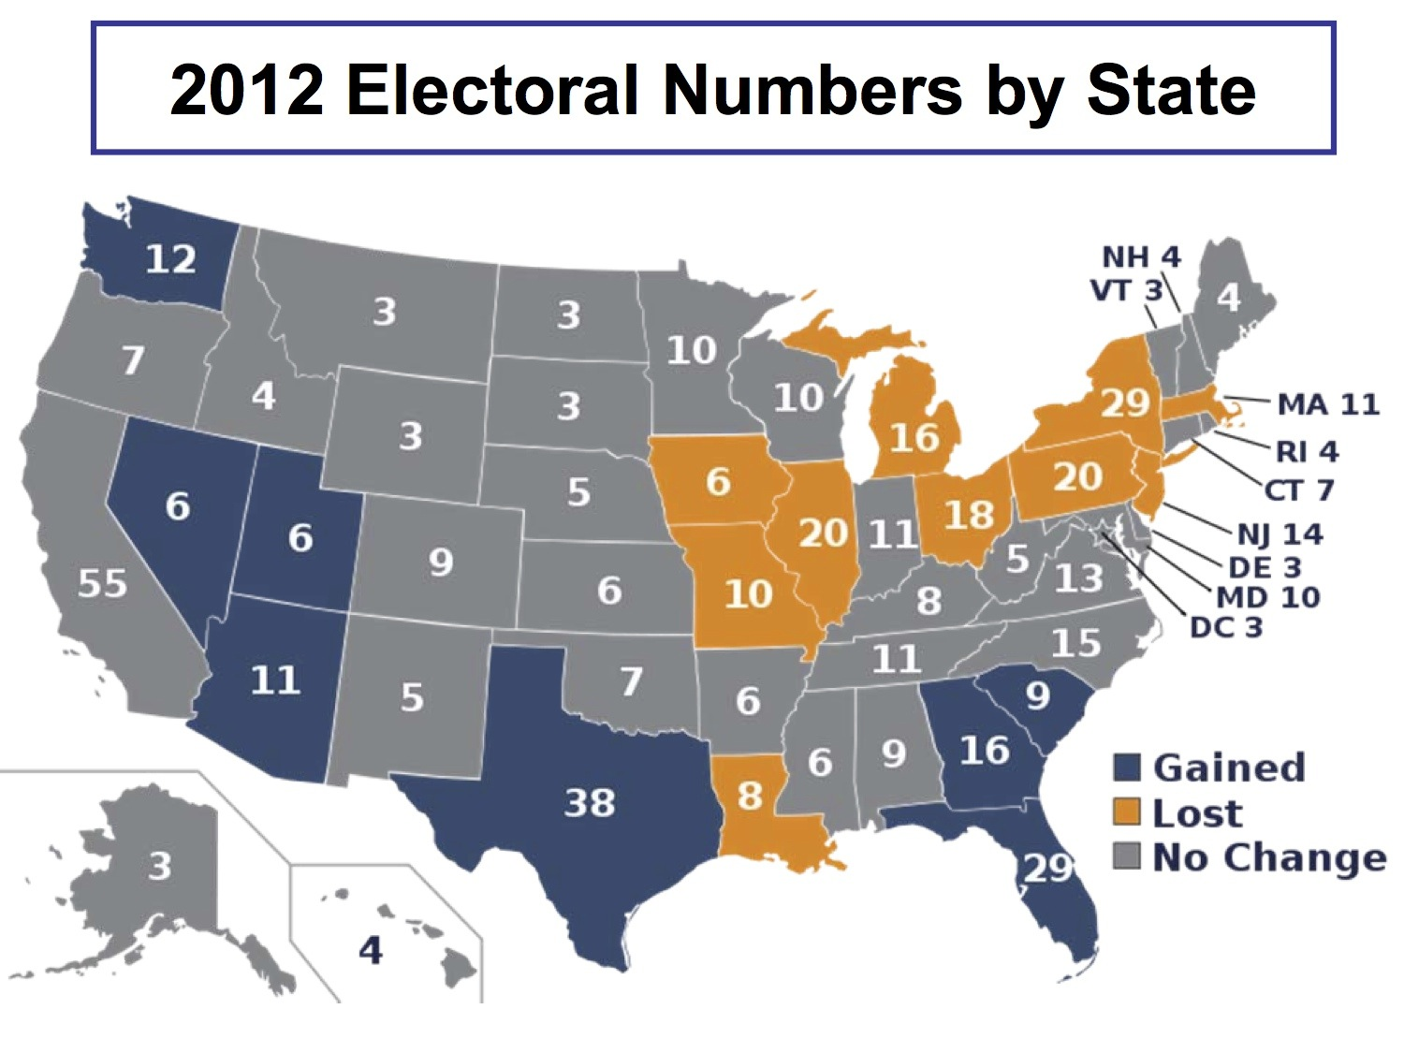

Slide 18
Electoral College
http://www.youtube.com/watch?v=bCjWPo70XZY
http://www.youtube.com/watch?v=bXc-mwhDTFw

Slide 19
Presidential Inauguration
The day a presidential inauguration occurs is known as “Inauguration Day” and occurs on January 20th.
Swearing In

Slide 20
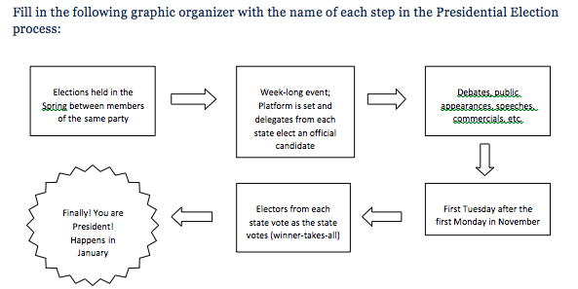
Becoming President

Slide 21
Electoral College
Pros
Cons

Slide 22
Electoral College
Pros
Cons
Removes election directly from the people
Maintains political stability by reinforcing the 2 party system
Ensures all parts of the country are involved
May not reflect popular vote
  2000 election
    Bush: 271; 50,456,002
    Gore: 266; 50,999,897
  2016 election:
    Trump: 304; 65,844,969
    Clinton: 227; 62,979,984
Small states and swing states given more power
Campaign bias
  Swing states
Potential for “faithless” electors

Slide 23
Writing Prompt
Do you think we should keep the Electoral College in place? Support your opinion with at least 3 specific reasons and explain how those reasons support your viewpoint.

Slide 24
Bellringer 3/24
What are the steps someone must go through to become president?

Slide 25
Factors that impact politics
Political Parties
Financing
Citizen’s background
Mass media
Lobbyists/interest groups

Slide 26
Political Parties
In democratic countries, citizens often join or support a political party.
The goal of political parties is to get their members in office.
Political parties often take different positions on key issues.

Slide 27
Political Spectrum
Parties can be placed on a political spectrum.
    Political spectrum (12): a system of classifying different political positions
Main test for place on the political spectrum is government involvement
  The more involved the government, the further left the concept – the less involved the government, the further right the concept
Where you fall on the spectrum impacts your political ideology
  Political ideology (13): a system of political beliefs or theories held by an individual or group

Slide 28
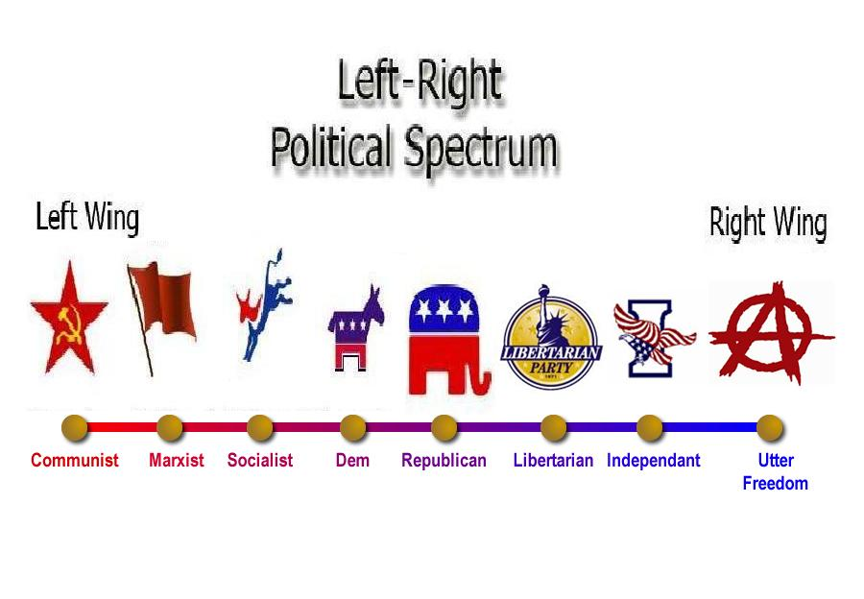
Political Spectrum

Slide 29
Role of Political Parties
Support Candidates
  Select candidates
  Raise money
  Promote
Influence voters
  Media
  Cues to voters
  Watchdog
Influence laws and policy
  Cooperation of branches
Unite levels of government
  Link local, state, and national
  Join forces to solve problems
Create balance
  Minority and majority interests

Slide 30
Two-Party System
In the United States we have a two party system,
  Two party system (14): System where two major political parties dominate voting in nearly all elections at every level of government
Each party tries to attract as many voters as possible
  neither party wants to offer policies that might be considered too extreme

Slide 31
Third Parties
Although we are a two party system, third parties do exist.
Third parties (15): political parties organized as opposition to the existing parties in a two-party system
Types: Single issue, ideological, and splinter.
Examples:
  Libertarian
  Green
  America First
  Working Families

Slide 32
Which party do you belong to?

Slide 33
Ideology Spectrum
LIBERAL | COMMUNITARIAN
LIBERTARIAN | CONSERVATIVE
Equality
Freedom
Freedom
Order

Slide 34
Two Party System
Democrats
Republican
Liberal
Big federal government
Favor increased federal services (welfare, social security, Medicare, student-loans)
Government intervention in the economy
Favor political and social reform, usually government-driven
Conservative
Small federal government
Tend to believe a large government threatens people’s freedoms
Support limited government involvement in economic issues (laissez-faire)
Tend to believe social problems handled on a smaller scale

Slide 35
Party Position
A party’s platform sets out their position
  List of the values and actions which are supported by a political party or candidate to appeal to the general public
  Drafted at national nominating convention
Each part of the platform is a plank.
  Any one of the stated principles or objectives of the political platform

Slide 36
Financing Campaigns
Private Financing
  Voters, business groups, labor unions, and etc.
  Congress passed the Federal Election Campaign Act (FECA) and created the Federal Election Commission (FEC) to enforce the law.
Public Financing
  Presidential Election Campaign Fund.
  $3 Tax check-off
  http://www.fec.gov/pages/brochures/contriblimits.shtml

Slide 37
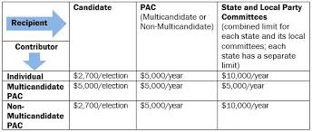

Slide 38
Financing Campaigns
The FECA led to the rise of PACs (political action committees) which spend money in elections but are not run by a party or candidate.
PACs are subject to contributions limits
  Limits on contributions received
  Limits on money given to candidates and parties
Most represent business, labor, or ideological interests.

Slide 39
PAC vs. Super PAC
Super PACs may not make contributions to candidates’ campaigns or parties directly but may engage in unlimited independent expenditures.
  Run ads, send mail, etc.
  Citizens United v. FEC: limits on independent expenditures is a violation of the 1st amendment.
No limits or restrictions on the sources of funds

Slide 40
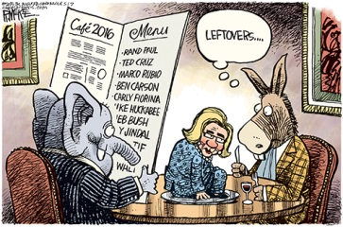

Slide 41
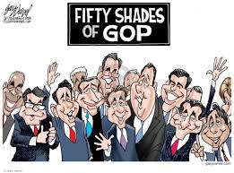

Slide 42
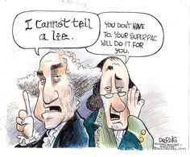

Slide 43
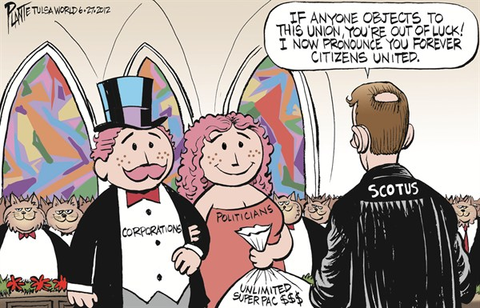

Slide 44
Ideology Analysis
You may work with one other person inspecting the viewpoints.
Summarize each point of view and why that is their stance on each issue.
When you have finished summarizing the parties POV, you should select two issues from “your party” (the results of short quiz).
You will then write one paragraph analyzing whether your personal beliefs align with your parties’ viewpoint on those two issues.

Slide 45
Bellringer: 3/27
What is the main purpose of political parties?

Slide 46
Public Opinion
Public opinion is the ideas and attitudes that most people hold about elected officials.
The government finds out what the public wants by analyzing polls
Public opinion is shaped by
  Personal backgrounds
  Mass media
  Interest groups

Slide 47
Mass Media
Mass media (17) forms of communication that transmit information to large numbers of people.
  Printed and electronic
Many ideas are directed at us for a purpose.
Propaganda (18): information, especially of a biased or misleading nature, used to promote or publicize a particular political cause or point of view
  http://www.youtube.com/watch?v=ohoXZ6EcneA
  Presidential Media Bias

Slide 48
Propaganda techniques
Testimonial
  Seeking endorsements from famous people
Bandwagon
  If you win over some, eventually more people will join
Glittering generalities
  Vague statements that have no real meaning but mass appeal
Stacked cards
  Presents one side of the case; may distort facts
Plain folks appeal
  Plain, average citizen that understands the common man
Name calling
  Unpleasant label or description to harm a person, group, or produce

Slide 49
For each commercial, determine which propaganda technique is being used. Then debate its effectiveness.
http://www.livingroomcandidate.org/commercials/1952
1952: Ike for President (Eisenhower)
1964: Peace Little Girl (Daisy) (Johnson)
1984: Prouder, Stronger, Better (Reagan)
1992: Journey (Clinton)
2000: Hopeful (Bush)
2004: Windsurfing (Bush)
2008: Yes We Can-Web (Obama)
2016: Movement (Trump); Role Models (Clinton)
After watching the examples, decide which technique you feel is most effective. Least effective. Explain.

Slide 50
Interest groups
Interest groups (16): organizations of people with a common interest that try to influence government policies and decisions
  Interest groups attempt to influence public policy by lobbying
Many interest groups hire lobbyists to represent them.
  Lobbyists are hired by a business or a cause to persuade legislators to support that business or cause

Slide 51
Lobbyists influence government
Lobbyists work with Congress
  Argue for and against bills
  Supply information for the bill
  Provide financial support for candidates
Lobbyists influence public opinion
  Place advertisements in the mass media
  Endorse candidates
Lobbyists attempt to lobby the executive
  Attempt to influence the decisions of agencies.
Lobbyists use the judiciary
  Use the courts to influence policy
  http://www.youtube.com/watch?v=8ugo8q1l-4s

Slide 52
Interest Groups
Look up your group’s assigned interest group. What does that group represent and provide an example of legislation that group may advocate for.
1 – AARP
2 – NRA
3 – NAACP
4 - NOW
5 – Sierra Club
6 – National Association of Wheat Growers
7 – PETA

Slide 53
Media Activity
Create 6 boxes on your sheet of paper.
In each box create an advertisement that demonstrates the use of each of the 6 types of propaganda.
Make sure you advertisement relates to the CIVICS subject matter.
Your assignment must be in color and be neat

