Slide 1
Bellringer 3/3
What are express powers? Provide one example. What are implied powers? Provide one example.

Slide 2
Leadership

Slide 3
Organization of congress
The Constitution has only three rules about organization.
House of Representatives to select a presiding officer and other officers
Vice president is the president of the Senate
Selection of Senator to preside in the vice president’s absence.

Slide 4
Organization of the house
Speaker of the House(12): Presides over the House when it is in session; most powerful member in House
Senior majority member
Powerful position
Determines when bills will be debated and voted on and committee assignments

Slide 5
Organization: Senate
Vice president is president of Senate but only votes if a there is a tie.
Majority party elects a president pro tempore.

Slide 6
Organization
House and Senate have floor leaders
Majority and minority
Assisted by the party whips.
Whip(13): an official in a political party whose job it is to count votes, encourage party loyalty, and ensure party’s members are present for votes
Chosen by parties in closed door caucuses.

Slide 7
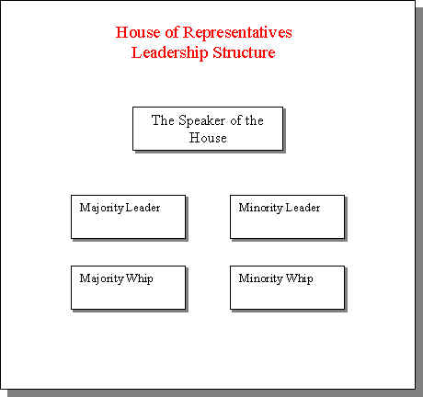
Organization of the House

Slide 8
Organization
Members are assigned to committees.
Chairperson heads committee
Biggest factor for assignments is seniority.
There are different types of committees.
House Committees
Senate Committees

Slide 9
Lawmaking

Slide 10
How a bill begins
A bill is a proposed law.
Both the House and Senate must pass the bill. Then it can be signed by the president and become a law.
A law is also known as an act.
School House Rock

Slide 11
Bill becomes law
Ideas for bills come from anywhere
US citizens
Congress
the president.
A bill will be drafted
Congress, executive branch, or outside groups
Bill will introduced in either the House or Senate (except which type?)
When the bill is introduced, it is assigned letters and a number (H.R. = House; S. = Senate)

Slide 12
Bill becomes law
After introduced bill referred to committee according to subject matter.
Will hold public hearings
Ashton Kutcher
SNAP
Will “mark up” the bill
If a committee reports favorably on a bill, it is calendared for debate and vote in the full chamber.

Slide 13
House acts on bill
After standing committee
Rules Committee to adopt the rules for debate.
The House debates and amends the bill.
The bill is then voted on.
If the bill passes it goes to the Senate/president
A quorum is needed to conduct business.
A quorum call is a vote to make sure there are enough members present.

Slide 14
The Senate acts on the bill
After standing committee
Senate debates and amend the bill
The bill is then voted on.
If the bill passes it goes to the House/president
Debate in the Senate is unlimited
Filibuster (14): extended debate or other procedures used to prevent a vote on a bill in the Senate
Cloture (15): A vote taken in the Senate to stop unlimited debate on a bill
Cloture can be invoked if 3/5 of the full Senate voting in favor.
A quorum is needed to conduct business.

Slide 15
Conference committee
If House and the Senate pass an identical bill, it is sent to the president.
If they pass different versions the bill is sent to a conference committee
Conference committee (16): a committee of Congress appointed by the House and Senate to resolve disagreements on a particular bill.
The compromise bill is sent back to both chambers to approve

Slide 16
The President acts on the bill
The president may take one of 3 possible actions:
Sign the bill and declare it to become law
Veto the bill and send it back to Congress with the reasons for rejection
Keep the bill for 10 days without signing it.
If Congress is in session the bill becomes a law.
If Congress is not in session the bill does not become a law
Pocket veto (17): veto where Congress adjourns within 10 days of submitting a bill to the president who lets it die by neither signing nor vetoing it.
Congress can override a veto with 2/3 vote.

Slide 17
What comes next?
After much debate, HR2245, a multi-billion tax package, passes the House.
The House and Senate have passed two different versions of a bill on Medicare.
The House Agriculture Committee decides to consider HR6532, a bill on stem cell research and reports on it favorably.
A compromise bill on the National Park System has passed both houses.

Slide 18
Group activity
With your group you are going to create a flowchart for how a bill becomes a law.
You must include the following terms:
Committee
Conference committee
Quorum
Rules committee
Filibuster
Cloture
Veto
Pocket veto
http://www.youtube.com/watch?v=BZFRP67sX8o
http://www.youtube.com/watch?v=HX8aFpnWxPA

Slide 19
Bellringer 3/6
Create a flow chart of the lawmaking process.

Slide 20
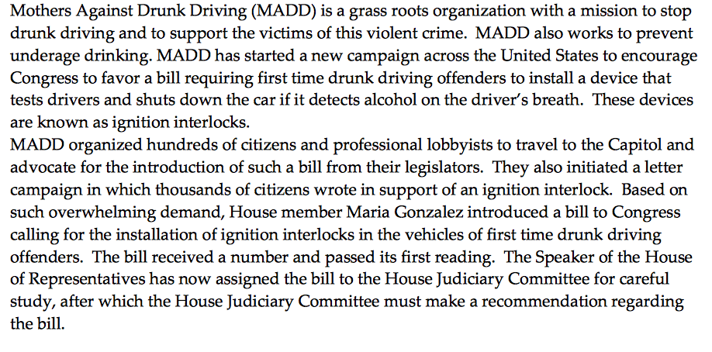
Committee simulation

Slide 21
Committee simulation

Slide 22
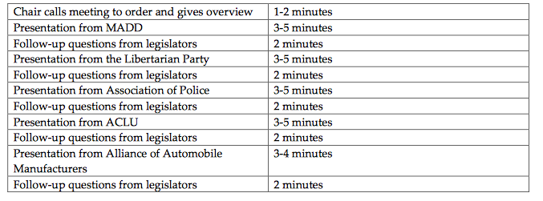
Committee simulation

