Slide 1
Legislative branch

Slide 2
Bellringer: 3/1
How is our legislative branch structured?

Slide 3
Terms and sessions
20th Amendment provides a term of Congress begins at noon on January 3 of every odd numbered year.
Currently 115th Congress.
Each term of Congress is divided into two sessions, one for each year of the term.

Slide 4
Two Chambers
Congress is the law making body of the federal government.
Article I, Section 1
“All legislative Powers herein granted shall be vested in a Congress of the United States, which shall consist of a Senate and House of Representatives.”
Bicameral(1): two chamber legislature
Great Compromise/Connecticut Plan
Ensure large states and small states fairly represented

Slide 5
House of representatives
The House has 435 members.
Each state has at least 1
Number per state depends on population
DC and Puerto Rico have nonvoting
Serve 2 year terms.
Elections in November of each even-numbered year.
House qualifications
25 years of age
US citizen for at least 7 years
Reside in state where elected
Agree to uphold a code of conduct

Slide 6
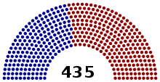

Slide 7
Senate
Senate has only 100 members; 2 per state
Serve 6 year terms
Election in November of even numbered years
Only 1/3 of Senate up for election every two years
Qualifications for Senate
30 years of age
US citizen for at least 9 years
Reside in state where elected
Agree to uphold a code of conduct
The 17th Amendment allowed for direct election of senators instead of state legislatures (1913).

Slide 9
Code of conduct
“Each House may determine the Rules of its Proceedings, punish its Members for disorderly Behavior, and, with the Concurrence of two thirds, expel a Member” Article I, section 5, clause 2.
Serious offense can lead to expulsion
Expulsion requires a 2/3 vote of the senators or representatives
Less serious offense may bring a vote of censure, or formal disapproval

Slide 10
Consecutive terms?
In 1995 in the case of U.S. Term Limits, Inc. v. Thorton, the Supreme Court held
“ State-imposed restrictions…violate a third idea central to this basic principle: that the right to choose representatives belong not to the States, but to the people…The Congress of the United States, therefore, is not a confederation of nations in which separate sovereigns are represented by appointed delegates, but is instead a body composed of representatives of the people.” – Justice Stevens
There are no term limits for members of Congress.

Slide 11
Representative Power of Congress
Members of Congress should
Inform constituents about issues
Correspond with constituents
Advocate local concerns
Help constituents access government

Slide 12
Organization of Congress
How do you decide how many representatives each state gets?

Slide 13
Apportionment
Apportionment (2) is the process by which legislative seats are distributed among units entitled to representation
http://www.youtube.com/watch?v=RUCnb5_HZc0
The Constitution requires that a census is taken every 10 years.
Less people = lose representative s
More people = gain representative

Slide 14
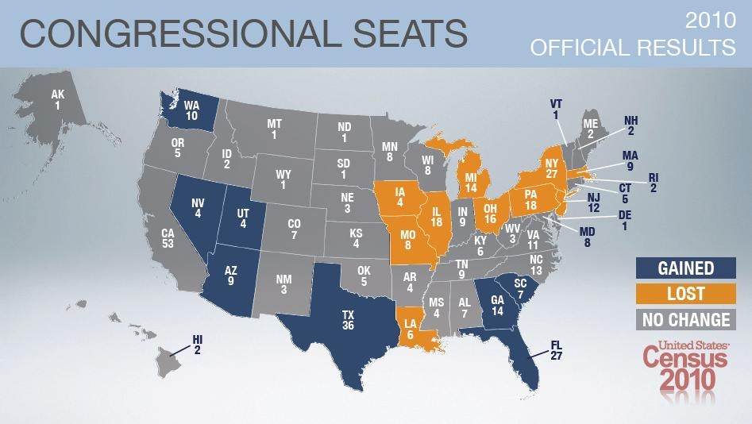

Slide 15
Apportionment
Voters elect their representatives according to their Congressional district.
Each state’s legislature takes their number of representatives and creates that many districts.
Ex: NC has 13 representatives, NC has 13 districts.

Slide 16
Wesburry v. Sanders (1964)
Wesburry v. Sanders (3): Supreme Court invalidated unequal congressional districts, saying that all legislative districts must contain about equal numbers of people.
Wesburry claimed that his vote was diluted because his district had more people.
Supreme Court decided the apportionment was a violation of the Equal Protection clause by some votes counting more than others.
“Helped establish One-person, one-vote” princpal
Required congressional districts be relatively equal in population

Slide 17
Apportionment
“One person, one vote” principle did not prevent gerrymandering
Gerrymandering (4) – practice of drawing district lines that favor a particular party, politician or group.
Crash Course gerrymandering

Slide 18
NC Congressional Districts
NC’s 12th Congressional District was considered to be an example of gerrymandering.
Challenged as a violation of the Equal Protection Clause.
In Reno v. Shaw, the Supreme Court held that districts can not be drawn strictly based upon race.

Slide 19
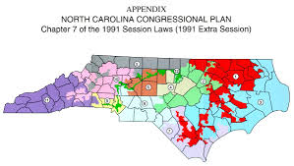
Reno v. Shaw

Slide 20
NC’s Congressional Districts
NC redrew congressional districts after the 2010 election.
NC’s congressional maps were debated and revised.
The congressional maps were granted approval by the DOJ, but lawsuits were still filed over aspects of the plans.
US District Court for the Middle District ruled District 1 and 12 constituted illegal racial gerrymanders in violation of the Voting Rights Act.
The court held state placed disproportionately large numbers of black voters in these two districts, thereby diluting the impact of their votes.

Slide 21
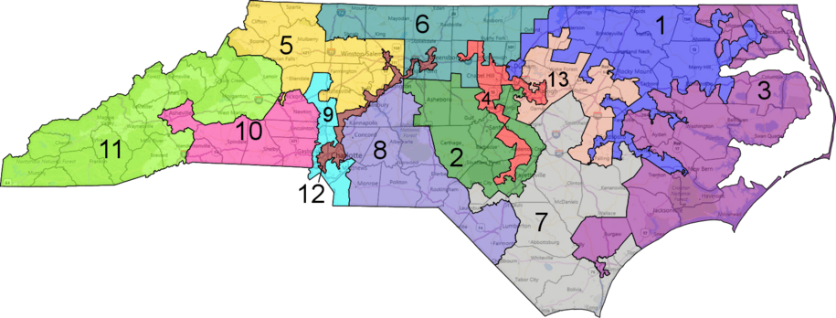

Slide 22
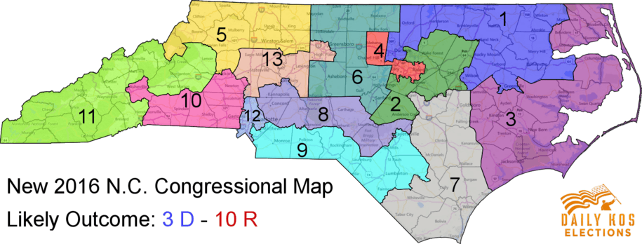

Slide 23
NC’s Congressional Districts
In December the Supreme Court heard oral arguments in the case of McCrory v. Harris to determine whether the original districts were constitutional.

Slide 24
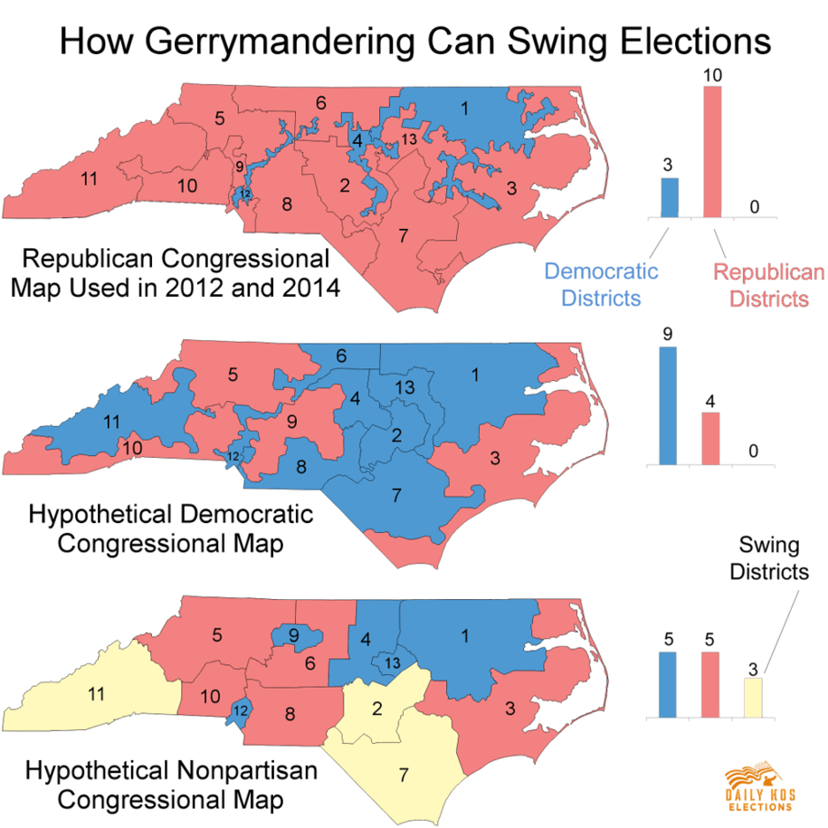

Slide 25
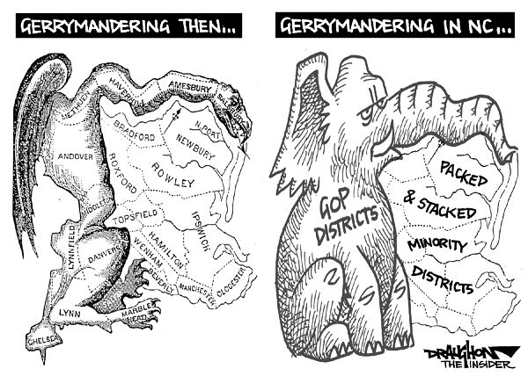

Slide 26
Bellringer 3/2
What is gerrymandering and how does it impact Congress?

Slide 27
Powers of congress

Slide 28
Constitutional Powers of Congress
Some of the powers of Congress have been expressly granted, or delegated by the Constitution.
Express powers (5): Powers that Congress has that are specifically listed in the Constitution.
Other powers are implied by the language of the Constitution.
Implied powers (6): Congressional powers found under the Necessary and Proper Clause; these powers are not specifically written in the Constitution.
Necessary and Proper Clause (7): Clause of the Constitution that enables Congress to make the laws required for the exercise its other powers

Slide 29
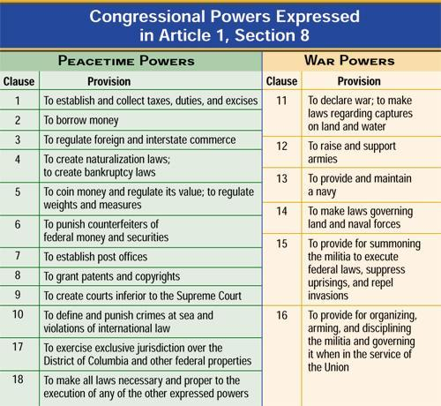

Slide 30
Article I, section 8
…Power To lay and collect Taxes, Duties…provide for the common Defense and general Welfare…
To borrow Money on the credit of the United States
To regulate Commerce with foreign Nations, and among the several States…
To establish an uniform Rule of Naturalization
To coin Money
To provide for the Punishment of counterfeiting the Securities and current Coin
To establish Post Offices
To promote the Progress of Science and useful Arts…exclusive right
Constitute Tribunals inferior to the supreme Court
To define and punish Piracies and Felonies… on the high Seas
To declare War
To raise and support Armies
To provide and maintain a Navy
To make Rules for the Government and Regulation of the land and naval Forces
To provide for calling forth the Militia to execute the Laws of the Union
To provide for organizing, arming, and disciplining, the Militia
To exercise exclusive Legislation…over the seat of government

Slide 31
Express powers
Article I, Section 8, lists the powers delegated to Congress. These powers can be group into categories.
Financing Government
Regulating Trade and Industry
Defending the Country
Establishing Courts
Providing for Growth

Slide 32
Express powers
Financing Government
Collect taxes to pay debts and provide for the general welfare
Borrow money for the US
Coin money and regulate its value
Punish counterfeiting of money
Regulating American Trade and Industry
Trade with foreign countries and among the states.
Establish laws for bankruptcy
Set up patent and copyright law

Slide 33
Express powers
Defending the Country
Punish crimes at sea
Power to declare war
To raise and maintain armies
Provide and maintain a navy
Set rules for armed forces
Establishing courts
Establish lower courts
Providing for Growth
Establish rules for naturalization
Establish post offices and roads
Govern the country’s territories

Slide 34
Gibbons v. Ogden
Gibbons v. Ogden (8): Supreme Court case that established an expansive view of the power of Congress under the Commerce Clause
Court decided that commerce is more than trading of goods, but includes the intercourse of commerce, such as navigation.
Court also held the issuance of a federal license would supersede a state license in the spirit of the Supremacy Clause.

Slide 35
Implied powers
The Constitution states that Congress has the power to “make all laws which shall be necessary and proper for carrying into execution the foregoing powers.”
The necessary and proper clause allows Congress to stretch delegated powers to cover many other areas.
Also called the elastic clause

Slide 36
McCulloch v. Maryland
McCulloch v. Maryland (9): Supreme Court case that established the federal government has “implied powers” to carry out, without state interference, any and all rights given by the Constitution.
Congress could create a bank under the Necessary and Proper Clause despite the Constitution not explicitly granting that power to Congress
Chief Justice Marshall’s opinion upheld a broad interpretation of the federal government’s powers.
Also upheld the supremacy of the federal government under the Supremacy Clause by establishing the precedent that states could not tax an activity of the federal government.

Slide 37
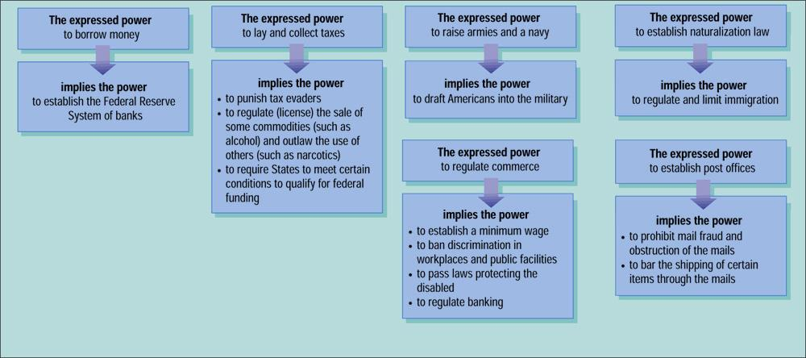

Slide 38
Other powers
The Constitution gives each chamber certain non-legislative powers.
The House of Representatives
Must start all bills for raising revenue
Appropriation bills (10): a legislative bill that authorizes the government to spend money
Congress has the POWER OF THE PURSE
Sole power to impeach public officials
Impeach (11): to charge a public official with wrongdoing
Chooses the president if no candidate receives enough electoral votes

Slide 39
Non legislative powers
Senate
Holds impeachment trials
VP usually acts as the judge; if the president is impeached, chief justice presides
2/3 of the Senate must find the official guilty before he or she can be dismissed from office.
Selects vice president if no candidate receives enough electoral votes
All treaties with foreign nations must be approved by 2/3 vote
Confirms presidential appointments

Slide 40
Limits on Powers
Do not forget the powers denied to Congress
Habeas Corpus: requires someone to justify a prisoner’s detention
Bill of Attainder: act of legislature declaring person guilty without a trial
Ex post facto laws: criminal law that applies retroactively
Favoring trade of one state
Cannot take the state’s reserved powers
Crash Course Bicameral Congress

