Slide 1
Executive Branch

Slide 2
Bellringer 3/7
What are some responsibilities of the president?

Slide 3
The Presidency
Constitution qualifications to be president:
Native born citizen of the US
Be at least 35 years of age
A resident of the United States for 14 years
The president is elected for a four-year term.
The 22nd amendment set a two-term limit to the presidency

Slide 4
Vice President
Serve as president if the president leaves, dies, or is unable to fulfill his/her duties.
25th Amendment specifies succession
Qualifications for vice president are the same as the qualifications for president.
The vice president also serves a four term.

Slide 5
Presidential succession
After the vice president
Speaker of the House
President pro tempore of the Senate
Members of the president’s cabinet in the order in which the departments were created.
Secretary of State
Secretary of Treasury
Secretary of Defense
Attorney General

Slide 6
Presidential Powers
Where are the president’s powers listed?
The president has both express and implied powers too.

Slide 7
Presidential Powers
Formal Powers of the President (enumerated/express)
Foreign:
Commander in Chief
Make treaties
Receive ambassadors
Domestic:
Grant pardons and reprieves
Appointments
Inform and convene Congress
Informal powers (implied)
Takes care that the laws be faithfully executed
Setting legislative agenda
Executive agreements
Power of persuasion
Use bureaucracy

Slide 8
President’s Roles
1. Commander in chief
2. Head of State
3. Chief Diplomat
4. Chief Executive
5. Party Leader
6. Economic Leader
7. Legislative Leader
Crash Course Presidential Power
Crash Course Presidential Power 2

Slide 9
President’s roles
Commander in Chief: The president is in charge of the U.S. armed forces.
The president decides where troops shall be stationed and how weapons shall be used.
War Powers Resolution (1973) – president may send forces where US interests are threatened for 60 days.

Slide 10
President’s Roles
Head of State - President is a living symbol of the nation.
As chief of state, the President:
Entertains foreign leaders
Recognizes citizens for contributions
Carries out ceremonial functions

Slide 11
President’s roles
Chief Diplomat - With the help of advisers, the president makes the foreign policy of the United States.
Foreign policy (18): country’s actions, words, and beliefs toward other countries
President appoints diplomats
Negotiates treaties with other countries
Need approved by a 2/3 of the Senate

Slide 12
President’s roles
Chief Executive – is the "boss" for millions of government workers in the Executive Branch; decides how the laws are to be enforced and chooses officials and advisors to help run the Executive Branch
Head of executive department
Executive order (19): a rule or order issued by the president to an executive branch of the government and having the force of law
Has the power to grant reprieves and pardons.
Reprieve: postpones the carrying out of a person’s sentence
Pardon: forgives a person for his/her crime and eliminates the punishment
Pardons
Pardons and commutations

Slide 13
President’s roles
Party Leader - In this role, the president helps members of his political party get elected

Slide 14
President’s roles
Economic Leader - Concerned with unemployment, high prices, taxes, and the general prosperity of the country.

Slide 15
President’s Roles
Legislative Leader – Can influence Congress in its lawmaking.
State of the Union Address (20): An annual message to Congress in which the president reports on the state of the nation and outlines a legislative program
Sends Congress a proposed budget
Veto power indicates what legislation the president does not want passed
2016
2014

Slide 16
Bellringer 3/8
List and describe 3 roles of the president.

Slide 17
Foreign or domestic?
What does it mean if something is foreign?
What does domestic mean?
“…ensure domestic tranquility…”

Slide 18
Agree or disagree?
The U.S. should support people who rise up to fight for democracy against dictators and repressive regimes in their countries.
American foreign policy should be focused on international relief efforts and humanitarian aid in troubled regions.
The US should push poor countries to change their policies to ones that will encourage foreign investment in profitable industries.
The U.S. should be less involved and intrusive in the affairs of other countries and let the nations in troubled regions work out their own solutions.

Slide 19
Foreign policy
US Foreign Policy is the country’s actions, words, and beliefs toward other countries.
The main goals of foreign policy are
Security interests
Economic interests
Ideological interests
Most often, the president and executive branch initiate foreign policy and work with the legislative branch to carry out those responses.

Slide 20
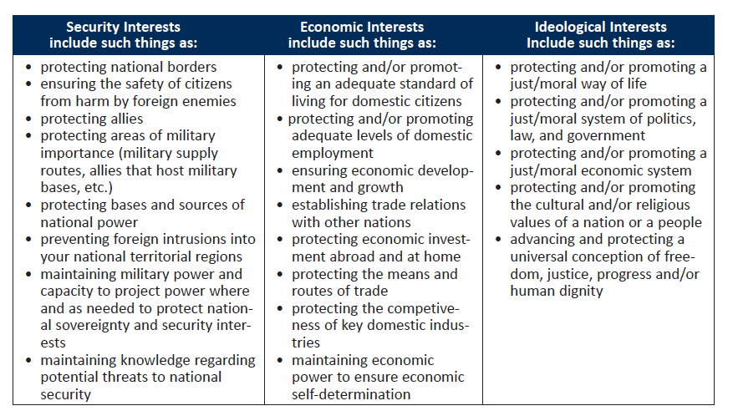

Slide 21
Tools of foreign policy
Creating treaties
Formal agreements between the governments of two or more countries
Senate must approve a treaty by 2/3 vote
President can bypass the Senate by making an executive agreement.
Treaties
Appointing Ambassadors
An official representative of a country’s government is an ambassador
The president appoints ambassadors, who must be confirmed by the Senate.

Slide 22
Tools of foreign policy
Foreign Aid
Foreign aid is the help or assistance that we give to other countries, usually through our Department of State.
Goal is the create friendship abroad and foster future trade partners.
This is money, food, military assistance, or other supplies
Military
Military is the country’s troops, led by our President who is the Commander in Chief
Goal is to prevent war and protect the United States.
The Department of Defense is made up of
Army
Navy
Air Force
Marines

Slide 23
Executive v. legislative
The United States Constitution divides foreign policy powers between the President and the Congress so that both share in the making of foreign policy
The President’s powers include:
Commands troops as Commander in Chief of all the armed forces
Appoint officials
Make treaties and executive agreements
Recognize new nations
Congress’ power include
The power of the purse; all foreign policy expenditures must be accounted for
Probe the Executive and its actions in oversight hearings
Foreign Affairs
Declare war
Approve treaties and appointments

Slide 24
Foreign Policy
Crash Course Foreign Policy
PollEverywhere
PBS

Slide 25
Bellringer 3/9
How do you think the executive is able to enforce all the laws that exist?

Slide 26
Federal Bureaucracy
The employees of the executive branch make up the federal bureaucracy.
Bureaucracy (21): the many departments, agencies, boards, commissions, and committees of the executive branch
The role of the bureaucracy is to help the executive branch carry out the laws.

Slide 27
Federal Bureaucracy
Organizations in the federal bureaucracy
Cabinet departments
Cabinet (22): Group that advises the president and is made up of the most senior appointed officers of the Executive Branch
Independent executive agencies
Independent regulatory agencies
Independent agency (23): Agency of the federal government that is independent of the Executive Branch and performs a specialized duty
Government corporations

Slide 28
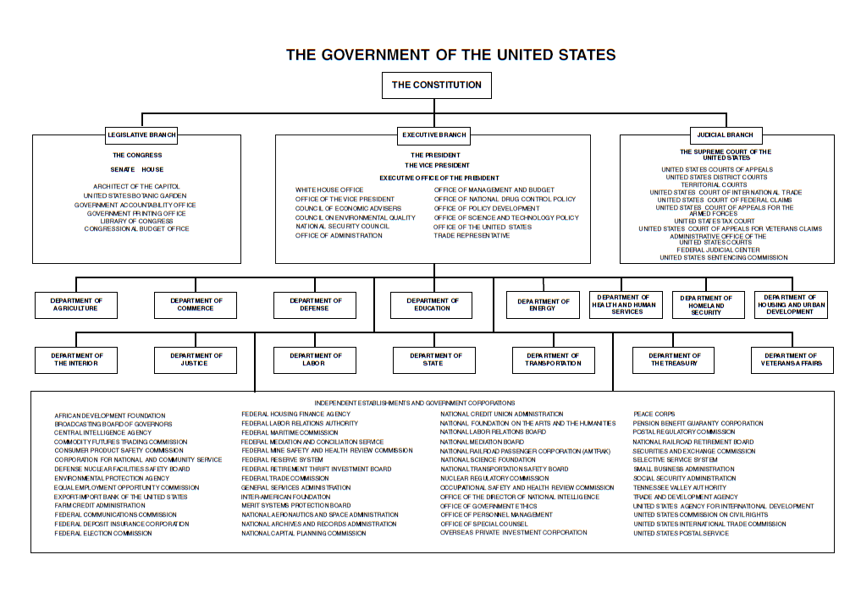

Slide 29
Cabinet
Cabinet: heads of 15 departments
Nominated by the president, confirmed by the Senate by a majority vote.
Head of department has title of secretary except Attorney General

Slide 31
Cabinet Departments
Department of State
Department of Defense
Department of Justice
Department of Homeland Security
Foreign Policy
is in charge of the nation’s armed forces and military bases
is the primary federal criminal investigation and enforcement agency
attempts to prepare for, prevent, and respond to domestic emergencies, particularly terrorism

Slide 32
Federal bureaucracy
Today, members of the bureaucracy are selected based upon a civil service system.
Employment based on open, competitive examinations and merit
A nonpartisan government
Civil service vs. spoils system

Slide 33
Agencies
Independent Executive Agencies fall outside the cabinet departments and perform a service function, not a regulatory one.
Headed by an administrator appointed by the president and confirmed by the Senate

Slide 34
Agencies
Independent Regulatory Agencies regulate a specific activity or interest.
Serve a quasi-legislative and quasi-judicial function
Make and enforce regulation
Deals with administrative law
Headed by a board serving staggered terms

Slide 35
Independent Agencies
CIA
NASA
EPA
FCC
FTC
FDA
FAA

Slide 36
Independent executive agencies
CIA (Central Intelligence Agency)
Gathers intelligence and provides national security assessments to policymakers in the United States. Foreign covert operations
NASA (National Aeronautics and Space Administration)
EPA (Environmental Protection Agency)
Works to control and decrease pollution and studies the impact of substances on the environment

Slide 37
Independent regulatory agencies
FCC (Federal Communications Commission)
To regulate interstate and international communications by radio, television, wire, satellite, and cable
FTC (Federal Trade Commission)
To assure that consumers are protected through enforcing anti-trust laws and creating consumer protection laws
FDA (Food and Drug Administration)
To assure the safety of the consumer when purchasing food and drugs
FAA (Federal Aviation Association)
To regulate and oversee all aspects of civil aviation

Slide 38
Oversight
Congress in 1946 began to develop procedures designed to oversee the Bureaucracy.
Congress can
Create or abolish agencies & departments
Investigate agency activities
hold committee hearings
pass legislation that alters an agency's functions
Crash Course Bureaucracy

Slide 39
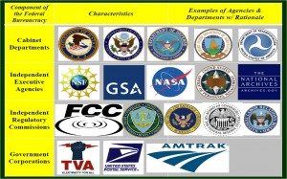

Slide 40
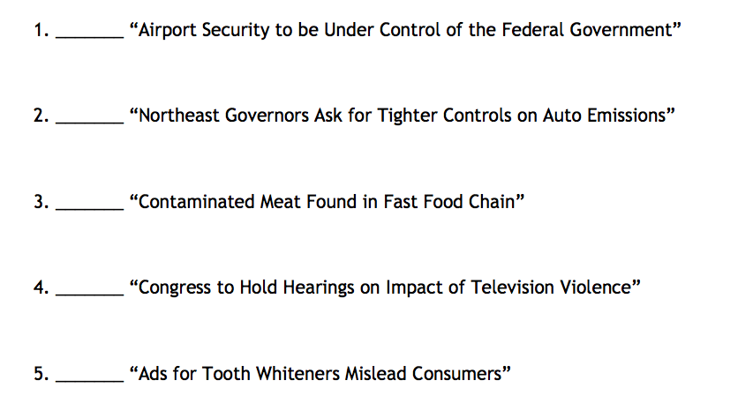
Independent Agencies

