Slide 1
Unit 2: The Constitution

Slide 2
Bellringer 2/22
What are the five principles of the Constituiton?

Slide 3
Constitution
Our Constitution came into effect in 1789. It is still in effect today.
The first Congress began on March 4, 1789.
President Washington was inaugurated on April 30, 1789.
The Bill of Rights were introduced by James Madison. The amendments came into effect on December 15, 1791 after ratification by the states.

Slide 4
The Constitution
Made up of three main parts:
Preamble
Articles
Amendments
How the Constitution is divided
Articles
Section
Clause

Slide 5
Preamble
The Preamble is an introduction that explains why the US Constitution was written.
Main question found in the Preamble
What goals are to be be reached?
http://www.youtube.com/watch?v=0EfnNUt_nwY

Slide 6
Preamble
We the People of United States, in Order to form a more perfect Union, establish Justice, insure domestic tranquility, provide for the common defense, promote the general Welfare, and secure the Blessings of Liberty to ourselves and our Posterity, do ordain and establish this Constitution for the United States.

Slide 7
Articles of the Constitution
Article I: Legislative Branch
Article II: Executive Branch
Article III: Judicial Branch
Article IV: Relations among States
Article V: Amending the Constitution
Article VI: Supremacy of National Government
Article VII: Ratification

Slide 8
Article I: Legislative Branch
Bicameral
House of Representatives: representation based on population
Senate: representation based on equality
Article I sets out the delegated powers of Congress
The express powers of
Article I, Section 8,Clause 18 grants Congress the implied powers to make all laws that are necessary and proper to carry out the delegated powers powers

Slide 9
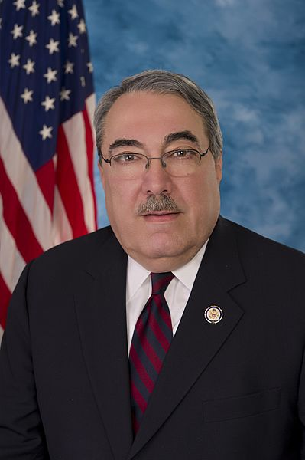
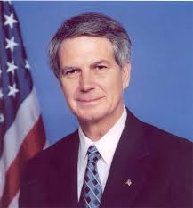
NC Congressional District 1 and 3

Slide 10
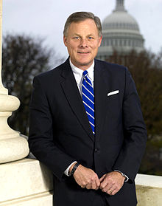
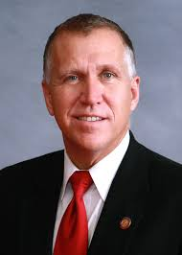
NC Senators

Slide 11
Article I: Legislative Branch
Powers denied to Congress
Bill of Attainder: A legislative act that singles out an individual or group for punishment without a trial.
Ex post facto: law that criminally punishes conduct that was lawful when it was done
Writ of habeas corpus: requiring that a person holding a prisoner must demonstrate the legal and jurisdictional basis to hold the prisoner
Powers denied to states:
Enter into treaties
Coin money
Grant titles of nobility

Slide 12
Article II: Executive Branch
Executive Branch
Consists of president and vice president.
Office
Term: 4 years
Term limits: 2 terms (22nd amendment)
Electors = members in House + Senate
Military title of Commander-in-Chief

Slide 13
Article III: Judicial Branch
Supreme Court is established and it is the highest court.
Treason is the only crime defined in Article III
Levying war, adhering to enemies, giving them aid and comfort
Testimony of 2 Witnesses to the same overt Act, or on Confession in open Court.
Judicial Review is not expressly established in Article III, came from Marbury v. Madison.
Judicial Review (15): Authority of the Supreme Court to determine whether acts or laws are constitutional.

Slide 14
Article IV: Relations among States
Full faith and credit clause (16): Clause that reads "public acts, records and judicial proceedings of every state given full faith and credit in every other state...“
Congress admits new states to the Union
Article guarantees a republican form of government

Slide 15
Article V: Amendments
Amendment (17): a written change made to the Constitution.
Been amended 27 times.
An amendment may be proposed in one of 2 ways:
2/3 vote in Congress
2/3 state legislatures request national convention
An amendment must then be ratified in one of 2 ways:
¾ state legislature
¾ states convention
If the people do not like the effects of an amendment, another amendment can be passed to repeal it.
1933: 21st amendment was passed to repeal the 18th

Slide 16
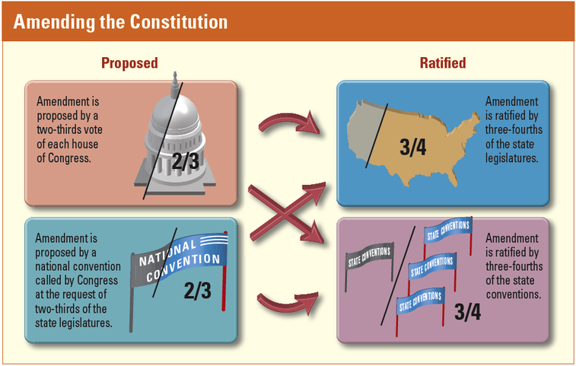

Slide 17
Article VI - VII
Article VI: Supremacy
Constitution and federal laws are the supreme law of the land
Congress members, state legislators, executive and judicial officers are bound by oath to support the Constitution
No religious test shall ever be required as a qualification to any office
Article VII: Ratification
9 states had to ratify the Constitution

Slide 18
Articles
Let’s eat jelly sandwiches and sugar rolls
Legislative
Executive
Judicial
States
Amendments
Supremacy
Ratification

Slide 19
Assignment
You are going to create a poster depicting a rhyme for each of the 7 Articles of the Constitution.
Each rhyme should help your remember what that article covers
Article one: how Congress is run
Article two: --------
Article three: -------

Slide 20
Bellringer: 2/23
How can you amend the Constitution?

Slide 21
Bill of Rights
Bill of Rights (18): the first ten amendments to the United States Constitution.
Calm any fears of the anti-federalists.
Ratified in 1791
Initially the amendments only applied to the federal government, however most apply to the states through incorporation by the 14th amendment.

Slide 22
Bill of Rights
First Amendment
“Congress shall make no law respecting an establishment of religion, or prohibiting the free exercise thereof; or abridging the freedom of speech, or of the press; or the right of the people peaceably to assemble, and to petition the Government for a redress of grievance.”

Slide 23
Bill of Rights
Second Amendment
“A well regulated Militia, being necessary to the security of a free State, the right of the people to keep and bear Arms, shall not be infringed.”
Third Amendment
“No Soldier shall, in time of peace be quartered in any house, without the consent of the Owner, nor in time of war, but in a manner to be prescribed by law”

Slide 24
Bill of Rights
Fourth Amendment
“The right of the people to be secure in their persons, houses, papers, and effects, against unreasonable searches and seizures, shall not be violated, and no Warrants shall issue, but upon probable cause, supported by Oath or affirmation, and particularly describing the place to be searched, and the persons or things to be seized”

Slide 25
Bill of Rights
Fifth Amendment
“No person shall be held to answer for a capital, or otherwise infamous crime, unless on a presentment or indictment of a Grand Jury, except in cases arising in the land or naval forces, or in the Militia, when in actual service in time of War or public danger; nor shall any person be subject for the same offence to be twice put in jeopardy of life or limb; nor shall be compelled in any criminal case to be a witness against himself, nor be deprived of life, liberty, or property, without due process of law; nor shall private property be taken for public use, without just compensation”

Slide 26
Bill of Rights
Sixth
“In all criminal prosecutions, the accused shall enjoy the right to a speedy and public trial, by an impartial jury of the State and district wherein the crime shall have been committed, which district shall have been previously ascertained by law, and to be informed of the nature and cause of the accusation; to be confronted with the witnesses against him; to have compulsory process for obtaining witnesses in his favor, and to have the Assistance of Counsel for his defence”

Slide 27
Bill of Rights
Seventh Amendment
“In suits at common law, where the value in controversy shall exceed twenty dollars, the right of trial by jury shall be preserved, and no fact tried by a jury, shall be otherwise re-examined in any court of the United States, than according to the rules of the common law”
Eighth Amendment
“Excessive bail shall not be required, nor excessive fines imposed, nor cruel and unusual punishments inflicted”

Slide 28
Rights of States and Citizens
Ninth Amendment
“The enumeration in the Constitution, of certain rights, shall not be construed to deny or disparage others retained by the people”
Tenth Amendment
“The powers not delegated to the United States by the Constitution, nor prohibited by it to the States, are reserved to the States respectively, or to the people”

Slide 29
BOR: First Amendment
Freedom of
Religion
Establishment clause (19): Congress cannot establish an official religion nor favor one religion over another
Free exercise clause (20): right to practice any or no religion
Assembly
Speech
Right to express ideas and opinions
Not an absolute right
Freedom of Press
Excludes false statements
Freedom of Petition
Ask your government to address your concerns

Slide 30
BOR: Protection of the People
Second
Bear arms
Third
No quartering soldier
Fourth
No unreasonable searches and seizures
Need a warrant

Slide 31
BOR: 5th Amendment Rights of the Accused
Grand jury indictment
Protection from self-incrimination
Double jeopardy
Due process
Can’t be denied life, liberty, or property without due process of the law
Eminent Domain - Government can take private property for public use if give owner fair payment

Slide 32
BOR: Rights of the Accused
Sixth Amendment: Right to
Speedy and public trial
Impartial jury
Confront witnesses
An attorney
Seventh Amendment
Jury trial in civil cases
Eighth Amendment
No Excessive nor cruel and unusual punishment

Slide 33
BOR: Rights of States and Citizens
Ninth Amendment
Americans enjoy basic rights not listed in the Constitution;
Power to the people
Tenth Amendment
Powers not specifically given to the federal government nor forbidden to the states, belong to the people or the states.
Power to the states

Slide 34
Since All Questions Seem Difficult, Study To Begin Passing Exams
Free Speech
Bear Arms
Quartering soldiers
Search and seizure
Due process
Speedy trial
Trial by jury in civil
Excessive bail or punishment
Protects unwritten rights of the people
Extra powers belong to the people
http://www.youtube.com/watch?v=tlt6R1KD4E0

Slide 35
Reflection
Choose one of the ten amendments included in the Bill of Rights and answer the following questions:
1. What does this right mean to you, personally?
2. How would your life or the lives of your family members be different without this right?
3. Give an example of a country where this right does not exist. How is it different than the United States?
4. Do you agree that this should be a right guaranteed to everyone in the United States? Why or why not

Slide 36
http://www.annenbergclassroom.org/page/the-story-of-the-bill-of-rights

