Slide 1
Unit 1: Role of Government

Slide 2
Analysis
One very important aspect of being a historian is the ability to analyze primary and secondary sources.
O: overview
P: parts
T: title
I: interrelationship
C: conclusion

Slide 3
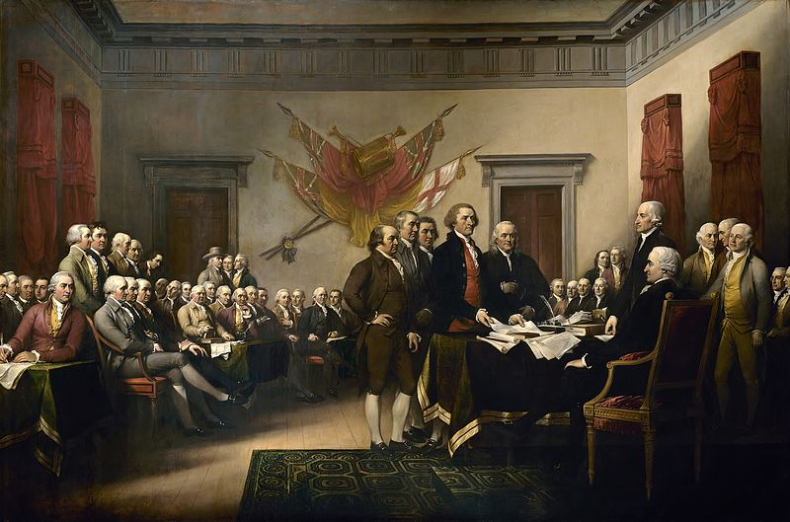
Notes:
John Trumbells (1817); 5 man drafting committee presenting their draft of the declaration which occurred on June 28, 1776, consisting of Jefferson, Franklin, Adams, Sherman, and Livingston.

Slide 4
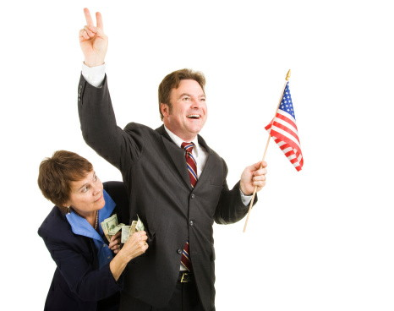

Slide 6
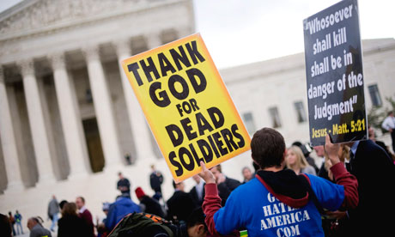

Slide 7
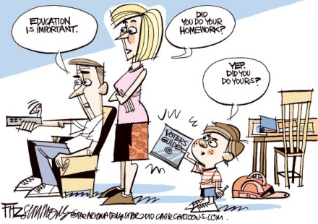

Slide 8
What is Civics?
Civics is the study of citizenship and government.
What does it mean to be a citizen?
A legal member of a country with certain rights and responsibilities

Slide 9
What is civics?
What is government?
People and institutions that establish order and protect rights
Why do we have governments?
make laws
keep order (competing interests of citizens)
provide services
guide community (public policy)
The ultimate role of the government is to promote the common good, doing the greatest amount of good for the greatest number of people.

Slide 10
Bellringer 2/1
Imagine we did not have a government. How would your life be different?
Intro

Slide 11
What is public policy?
Polices are the way of doing something.
Policies are the means of achieving goals.
Goal = feel safe walking at night
Policy = increase police patrol of the city
Many policies are translated into law by government action.
Private policies are the policies that businesses and individuals have adopted.
Public policies (1) are policies governments adopt to address problems.

Slide 12
Public Policy
When analyzing problems you need to look at both the causes and effects. Why?
Cause: how to change/address problem
Effect: priority of problem

Slide 13
What is public policy?
With your group discuss and record the following:
1. What are some examples of policies you can think of? Are these private or public?
2. What are some institutions that create public policy?

Slide 14
Public Policy
Public policy is created in a cycle:
Public address concerns
People reflect on policies Linkage institutions link people’s
concerns to government
Policies are implemented Policymaking institutions
create policy

Slide 15
Public Policy
Policy: In the past six years, many states have enacted laws restricting cell phone use while driving.
What problems are these policies trying to address?
Problem: People who are extremely overweight are more likely to have serious health problems. More children are being diagnosed with problems such as diabetes related to being overweight.
What should be the goal of the policies to address this problem?
What policies might a school district enact to address this problem?
Policy: A school has a policy of leaving four minutes between classes, which many students feel is not enough time and results in many students being tardy.
What is the problem?
What can be done about the problem policy?

Slide 16
Public Policy
Problem: Many people are being killed by drunk drivers
What should be the goal of the policies to address this problem?
What policies can state legislatures enact to address this problem?
Why is policy important?
Why is it important to analyze policy?

Slide 17
Goal
Rivals
Advantage
Disadvantages
Evaluation

Slide 18
Assignment
With your group you are going to read about a certain problem or issue and analyze the policy that was created to address it.
Students will
Carefully read over their case study
Work with their group to complete the GRADE analysis
As a class we will
Hold a brief discussion on the policies

Slide 19
Classwork/Homework
Your are going to search for a news article that discuss at least two of these three things:
Problems
Policy
Government
Write two sentences about each of the following:
A. The problem described by the article
B. Policy connections
C. Government connections
D. What interests you about this policy/problem?
Notes:
to

Slide 20
