Slide 1
Revolution
American Revolution and Declaration

Slide 2
Bellringer 2/7
Which of the Enlightenment philosophers do you think was most influential in the US? Why?

Slide 3
Causes of the American Revolution
The American Revolution consisted of colonists response to British Actions.
Not all Americans were supportive of the fight for independence.

Slide 4
British Actions that led to the American Revolution
Research your assigned cause of the Revolution.
With your group you will create a visual to represent the British action.
Mercantilism
French and Indian War
Writs of Assistance
Navigation Acts
Proclamation of 1763
Stamp Act
Townshend Acts
Coercive/Intolerable acts
Quartering Act

Slide 5
British Actions
Mercantilism
Mercantilism (13): Economic theory that states a country becomes stronger by keeping strict control over its trade.
A nation should have a favorable balance of trade.
Colonies provided raw materials; Britain created manufactured goods

Slide 6
British Actions
Navigation Acts
Acts passed in 1660s forcing colonies to trade only with Britain.
Also had requirements of using British ships and crews, but not strictly enforced until mid 1700s; salutary neglect
French and Indian War: 1754-1763
F&I War (14): Fight between Britain and France over control of colonies and trade routes; high costs led to many of the taxes established by Parliament.
Proclamation of 1763
Forbade settlers from settling west of the Appalachian mountains; created to stabilize relations with Native Americans

Slide 7
British Actions
Writs of Assistance
Allowed customs officials to search for smuggled goods for any reason
Served as a general search warrant
Quartering Act; 1765
Required the colonists to provide the basic needs of British soldiers
Stamp Act; 1765
Stamp Act (15): Direct tax imposed by the British on the colonies that required them to pay a tax on every piece of printed paper
Act led to the development of saying "no taxation without representation"

Slide 8
British Actions
Townshend Acts; 1767
Act that created an import tax on lead, paint, tea, paper, and glass; purpose was to raise revenue and establish precedent that Britain could tax colonists
Could search and seize items not paid taxes on
Intolerable Acts; 1774
Acts that were a set of punitive laws that served as Britain's response to the Boston Tea Party; closed port in Boston and stripped of self government

Slide 9
Colonist Reaction
Sons of Liberty
An organization formed to protect rights of citizens and support American independence.
Non-importation Association; 1768
Commercial restrictions to protest British taxation
Agreed to boycott British imports until Parliament repealed the Stamp Act.
Boston Massacre; 1770
Culmination of civilian-military tensions leading to British soldiers firing into the crowd and killing five civilians.
Boston Tea Party; 1773
After officials in Britain refused to return three shiploads of taxed tea to Britain, colonists destroyed the tea by throwing it in the harbor

Slide 10
Colonist Reaction
Continental Congress; September 1774
Decide how to respond to abuses by British authorities.
Continued boycott
Assembled a list of 10 resolutions stating their rights.
Agreed to meet again
Continental Congress (17): a convention of delegates called together from the Thirteen Colonies which became the governing body of the United States (USA) during the American Revolution.

Slide 11
Colonist Reaction
Battles of Lexington and Concord; 1775
First military engagements of the American Revolution
School House Rock
https://www.youtube.com/watch?v=HlUiSBXQHCw
Second Continental Congress; May 1775
Continental Army
Declaration of Causes =reasons for taking up arms
Olive Branch Petition requesting peace.
Common Sense; 1776
Common Sense (16): Pamphlet by Thomas Paine that was written in everyday language; advocated for independence from Great Britain
Declaration of Independence; 1776

Slide 12
Opposing views
As tensions between the colonists and Britain, many colonists developed strong opinions in support or against the revolution.
Patriots supported the movement for independence.
Loyalists remained loyal to Britain

Slide 13
Opposing views
Is the following quote from a patriot or loyalist?
“If I must be enslaved let it be by a King, at least, and not by a parcel of upstart lawless Committeemen. If I must be devoured, let me be devoured by the jaws of a lion and not gnawed to death by rats and vermin.” Samuel Seabury

Slide 14
Opposing views
Is the following quote from a patriot or loyalist?
“Gentlemen may cry, Peace, Peace – but there is no peace. The war is actually begun! The next gale that sweeps from the north will bring to our ears the clash of resounding arms! Our brethren are already in the field! Why stand we here idle? What is it that gentlemen wish? What is life so dear, or peace so sweet, as to be purchased at the price of chains and slavery? Forbid it, Almighty God! I know not what course others may take; but as for me, give me liberty or give me death!”

Slide 15
Analyzing a political cartoon
O - overview
P - parts
T - title
I - inference
C – conclusion

Slide 16
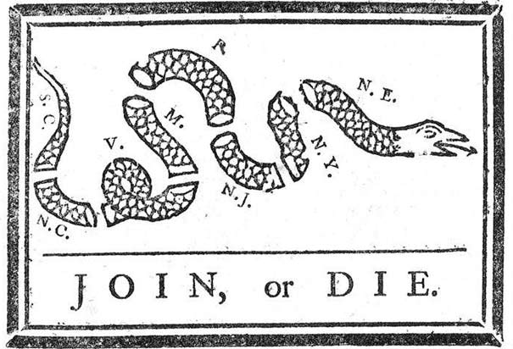
Opposing views

Slide 17
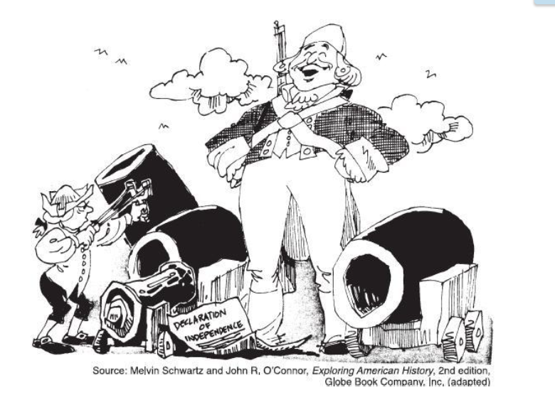
Opposing views

Slide 18
Reflection
1. If you were a colonist living in the late 1700s, which event, tax, or law would have angered you the most and why?
2. Which response of the colonists do you think was most effective.
3. Imagine if Patriots had not acted on their displeasure of the actions of Britain. What would America be like if we did not fight the American Revolution?

Slide 19
Bellringer: 2/8
How did ideas about self governance apply to the Continental Congress?

Slide 20
North Carolina
Before the Declaration of Independence was issued, North Carolina created their own documents.
Mecklenburg Resolves, 1775
British laws were no longer in effect
creation of an independent local government
Halifax Resolves, 1776:
Recommended NC and other colonies declare independence

Slide 22
Declaration of independence
The Congress, acting as government for the colonies, appointed a committee to write a document that would announce the independence of the United States.
Declaration of Independence (18): document that announced the independence of the United States.
Based on the idea of egalitarianism
Believing in the principle that all people are equal and deserve equal rights
Jefferson wrote the first draft of the Declaration

Slide 23
Declaration of independence
First Part - Preamble and philosophy
Second Part - List of grievances
Third Part - statement of independence

Slide 24
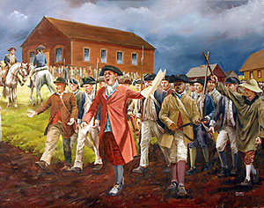

Slide 25
After independence
The states existed as 13 independent states with 13 different governments.
Every state wrote its own constitution
Legislature, governor, and courts.
Most had a bill of rights

Slide 26
Articles of confederation
Articles of Confederation (19): written agreement ratified in 1781 by the thirteen original colonies and served as our first plan of government.
The American Revolution ended in 1783.
Treaty of Paris Great Britain recognized the independence of the United States.
The states were now a confederation called the United States of America.

Slide 27
Articles of Confederation
Under the AOC the central government had very limited powers due to the states’ fear of a strong central government.

Slide 28
Weaknesses of Articles
Lack of Power and Money
Congress had no power to collect taxes
Congress had no power to regulate trade
Congress had no power to enforce its laws
Rules too Rigid
Approval of nine states to pass laws
The Articles could not be changed without the agreement of all 13 states.
Lack of Central Powers
Only one branch of government
No executive branch
No national court system existed

Slide 29
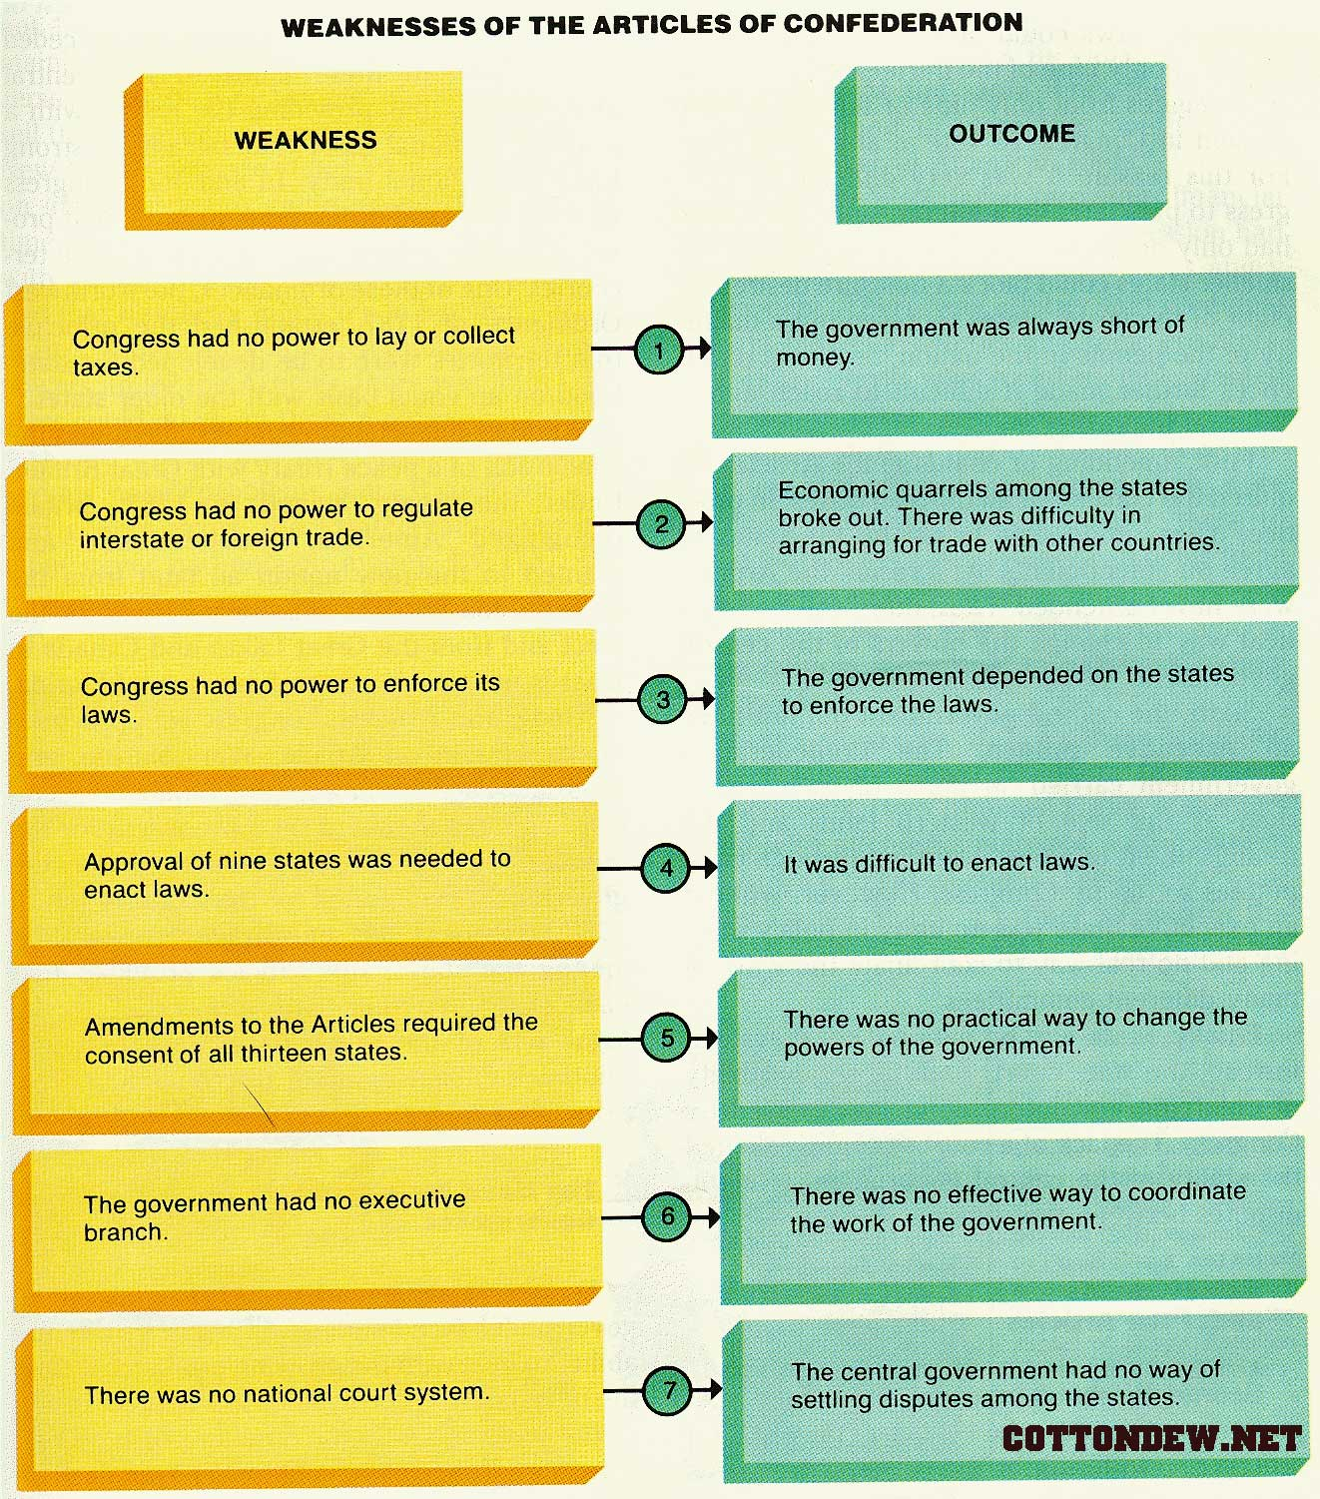

Slide 30
Shays’ Rebellion
Shay’s Rebellion (20): was an armed uprising in Massachusetts led by farmers in 1786 against the treatment of debtors; revealed need to revise the Articles.
As a result of inability to pay taxes and debts, many farmers had land seized and thrown in jail
They called special meetings of the people to protest
Closed courts and released debtors from jail
They came under the leadership of Daniel Shays.
Federal government was unable to recruit soldiers for the army, a privately funded army that was able to quash the rebellion
Shays’ Rebellion served as an indicator of the weakness of the Articles of Confederation and the need to have a stronger federal government.
Hip Hughes History

Slide 31
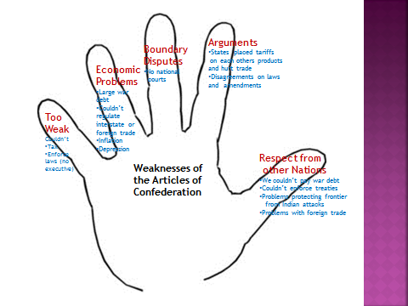

Slide 32
Reflection
Predict how the weakness of the Articles of Confederation could be resolved.

Slide 33
True or false: aoc
1. The Articles of Confederation created a President to lead the country.
2. States were still independent under the Articles.
3. The Articles were easy to change.
4. Under the Articles of Confederation, the more people a state had, the more votes it got in Congress.
5. The Congress created by the Articles did not have the power to collect taxes.
6. Under the Articles, states had to obey the laws Congress passed.
7. The Articles of Confederation created the first American government

