Slide 1
Origins

Slide 2
Bellringer 2/3
Some argue that the US is an oligarchy. Do you agree or disagree and why?

Slide 3
Original ideas?
There are certain big ideas that exist in our political documents.
Philosophical ideas or ways of thinking are often integrated into a nation’s founding and development.

Slide 4
Big Idea | Definition | From where does this originate? | Examples in our government today.
Self- Governance
Limited Government
Rule of Law
Due Process
Rights

Slide 5
Original Ideas?
Self Government
Limited Government
Rule of Law
Due Process
Rights
People can make decisions on how their government works
Government has limited power by a constitution or agreement.
Law should govern a nation and not arbitrary decisions of government officials
People have the right to fair and reasonable laws. Officials have to follow rules when enforcing laws.
A set of things people believe should be free to do without restrictions.

Slide 6
Self-Government
The colonies rebelled and declared independence in 1776. However, the colonies had been practicing limited forms of self government since the 1600s.

Slide 7
Self government
House of Burgesses: First elected body of representatives in the English colonies; 1619
Mayflower Compact (6): First agreement for self-government to be created and enforced in the English colonies; 1620
Document bound the signers into a "Civil Body Politic" for the purpose of passing "just and equal Laws . . . for the general good of the Colony."
Fundamental Orders of Connecticut: First constitution in the New World; 1636
Government is based in the rights of an individual
Albany Plan of Union: Proposal by Benjamin Franklin to organize the colonies into one government; 1754

Slide 8
British influence
Britain also served as a role model for American government.
Magna Carta
English Bill of Rights
Parliamentary system
Common law

Slide 9
British Influence: Magna Carta
Nobles became used to having certain rights and powers. When King John tried to take back some of these rights, the nobles rebelled.
The nobles were powerful enough to force the king to sign an agreement
Magna Carta (7): a document constituting a fundamental guarantee of rights and privileges English barons forced King John to sign in 1215.

Slide 10
British Influence: Magna Carta
Governments are based a contract between the ruler and people to be ruled.
Contract between the king and the nobility.
King = not deprive nobility of rights
Nobility = support the king
Set out laws that everyone, including the king, had to abide by.
Laid the ground work for Parliament and constitutional monarchs.

Slide 11
English Bill of Rights
In 1689, Parliament drafted an act stating the rights of Parliament and individuals.
English Bill of Rights (8): An act declaring the rights and liberties of the subject and settling the succession of the Crown signed in 1689.
The English Bill of Rights gave Parliament the balance of power in the English government.
By the end of the 17th century, the British government became increasingly limited in what it could do.

Slide 12
English Bill of Rights
The English Bill of Rights gave Parliament the balance of power in the English government.
It guaranteed certain rights and provided protections.
Elections to Parliament must be free
People have the right to keep and carry weapons
Kings and queens were not allowed to collect taxes without the consent of Parliament
Could not interfere with the right to free speech and debate that went on in Parliament,
Could not require excessive bail or administer cruel punishment for those accused or convicted of crimes,
Could not declare that laws made by Parliament should not be obeyed.
By the end of the 17th century, the British government became increasingly limited in what it could do.

Slide 13
British influence
Parliamentary system: democratic governance where the executive gets its legitimacy from the legislative branch
Bicameral: House of Lords and House of Commons
Head of government is Prime Minister, usually chosen from the political party that holds the most seats in the House of Commons.
Common law: past legal precedent or judicial ruling is used to decide cases.

Slide 14
Bellringer 2/6
What is a right you believe all people should have. How can that right be protected?

Slide 15
Enlightenment
Age of Reason – Period in the 1600-1700s in Europe of new and old ideas.
Philosophers
Niccolo Machiavelli
Thomas Hobbes
John Locke (9): English philosopher whose ideas heavily influenced US government including natural rights, social contract, and consent of the governed.
Baron de Montesquieu (10): French philosopher who advocated the separation of legislative, executive, and judicial powers.
Jean Jacques Rousseau
Voltaire
American colonists brought with them knowledge of Enlightenment theories and these theories impacted our government.

Slide 16
Machiavelli
Wrote about the ways government should operate.
Leaders may have to set aside ethical concerns to maintain the stability of the state.
Successful leaders were those that were willing to do what was needed to continue to have power.
Later wrote about the early concept of checks and balances and his work became a central text

Slide 17
Thomas Hobbes
Hobbes believed that in nature people were cruel, greedy, and selfish.
Nature = war
No one produced anything out of fear of it being taken
To escape this people would enter into a social contract, they would agree to give up their freedom in return for the safety and order.
Hobbes believed that a powerful government like an absolute monarchy was best for society.
People unable to overthrow government

Slide 18
John Locke
Believed in natural laws and natural rights.
Natural Rights (12): privileges and basic freedoms people are entitled to simply because they exist.
At birth people have the right to life, liberty, and property.
State of nature has no rules and no way to protect natural rights.
Role of government is to protect people’s rights. If the government fails, the people have the right to overthrow it.
Best form of government is one which is accepted by all of the people and has limited power.
Consent of the governed (11): a condition for a legitimate government, that the authority of the government should depend on consent of the people.
Most famous works are the Two Treatises on Government.

Slide 19
Montesquieu
Strongly criticized absolute monarchy and was a voice for democracy.
Believed the best way to protect liberty was to divide the powers of government into three branches
Each branch of government should check (limit) the power of the other two branches. Thus, power would be balanced (even) and no one branch too powerful.

Slide 20
Jean jacques rousseau
State suppresses physical rights
The social contract was the path to freedom.
The general will of the people as a whole should direct the state toward the common good.
Good of the community > individual interests.

Slide 21
Voltaire
“Think for yourself and let others enjoy the privilege of doing so too.”
“It is better to risk saving a guilty person than to condemn an innocent one.”
I do not agree with what you have to say, but I'll defend to the death your right to say it.”
“Liberty of thought is the life of the soul.”

Slide 22
Voltaire
Advocated freedom of thought, speech, politics, and religion.
Fought against intolerance, injustice, inequality, ignorance, and superstition.
Attacked idle aristocrats, corrupt government officials, religious prejudice, and the slave trade.

Slide 23
Locke and Hobbes
1. Why would the basic nature of humans be a topic of discussion?
2. Why would this be important for developing a concept for an ideal form of government?
3. How would these writers have come up with their point of view?
4. How could Locke and Hobbes have come to such different conclusions?

Slide 24
Enlightenment thinkers
Thomas Hobbes
Believed absolute monarchy was the best form of government
Social contract: gave up rights for protection
John Locke (9): English philosopher whose ideas heavily influenced US government including natural rights, social contract, and consent of the governed.
Natural rights: life, liberty, ownership of property
Social contract: between government and citizens; government protects rights and if government fails, people replace it.
Consent of the governed
Rousseau
Equality of citizens
Social contract – greater good
Montesquieu (10): French philosopher who advocated the separation of legislative, executive, and judicial powers.
Government divided into 3 branches
Checks and balances
Voltaire
Individual rights

Slide 25
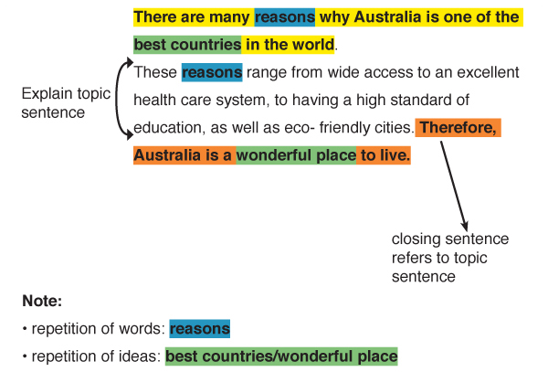
Writing
What is a thesis? According to Merriam Webster, a thesis is a statement or theory that is put forward as a premise to be maintained or proved.

Slide 26
Writing Prompt
Prompt: Who is the most influential thinker of the Enlightenment? Defend your answer by comparing your pick to at least two other thinkers of the same period. Provide strong detail and analysis in discussing your choice.

